Slide 1
Deep Learning
Introduction to Deep Learning

Slide 2

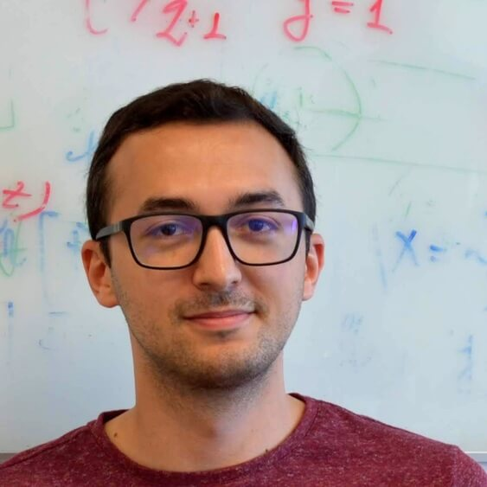
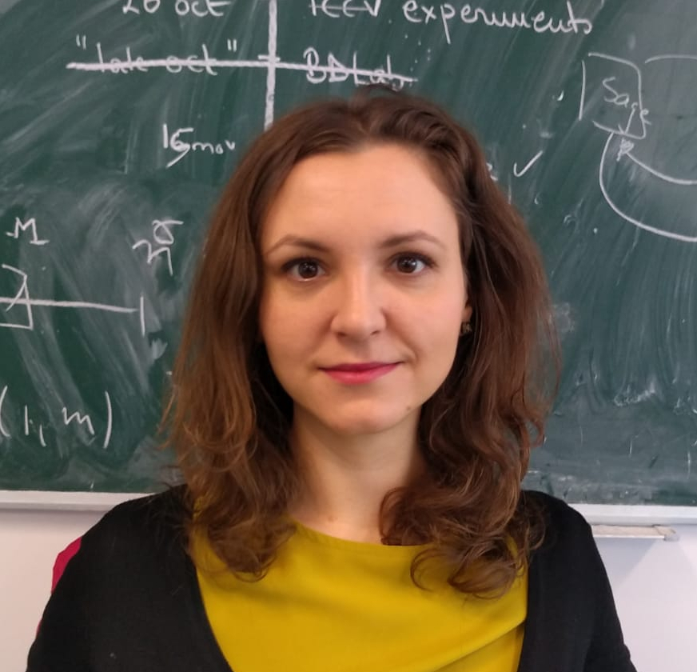
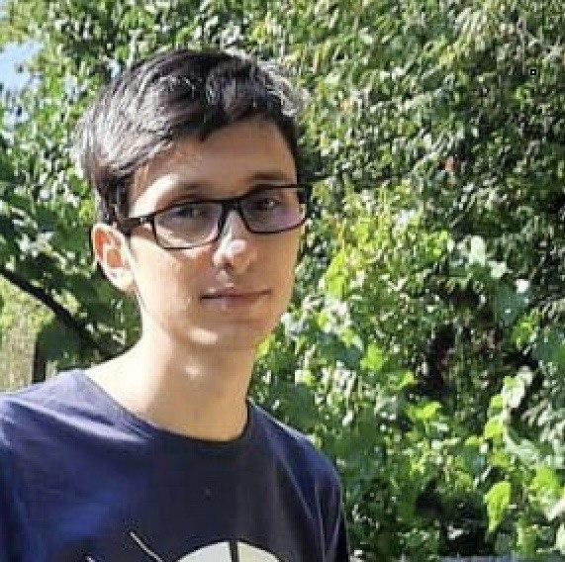



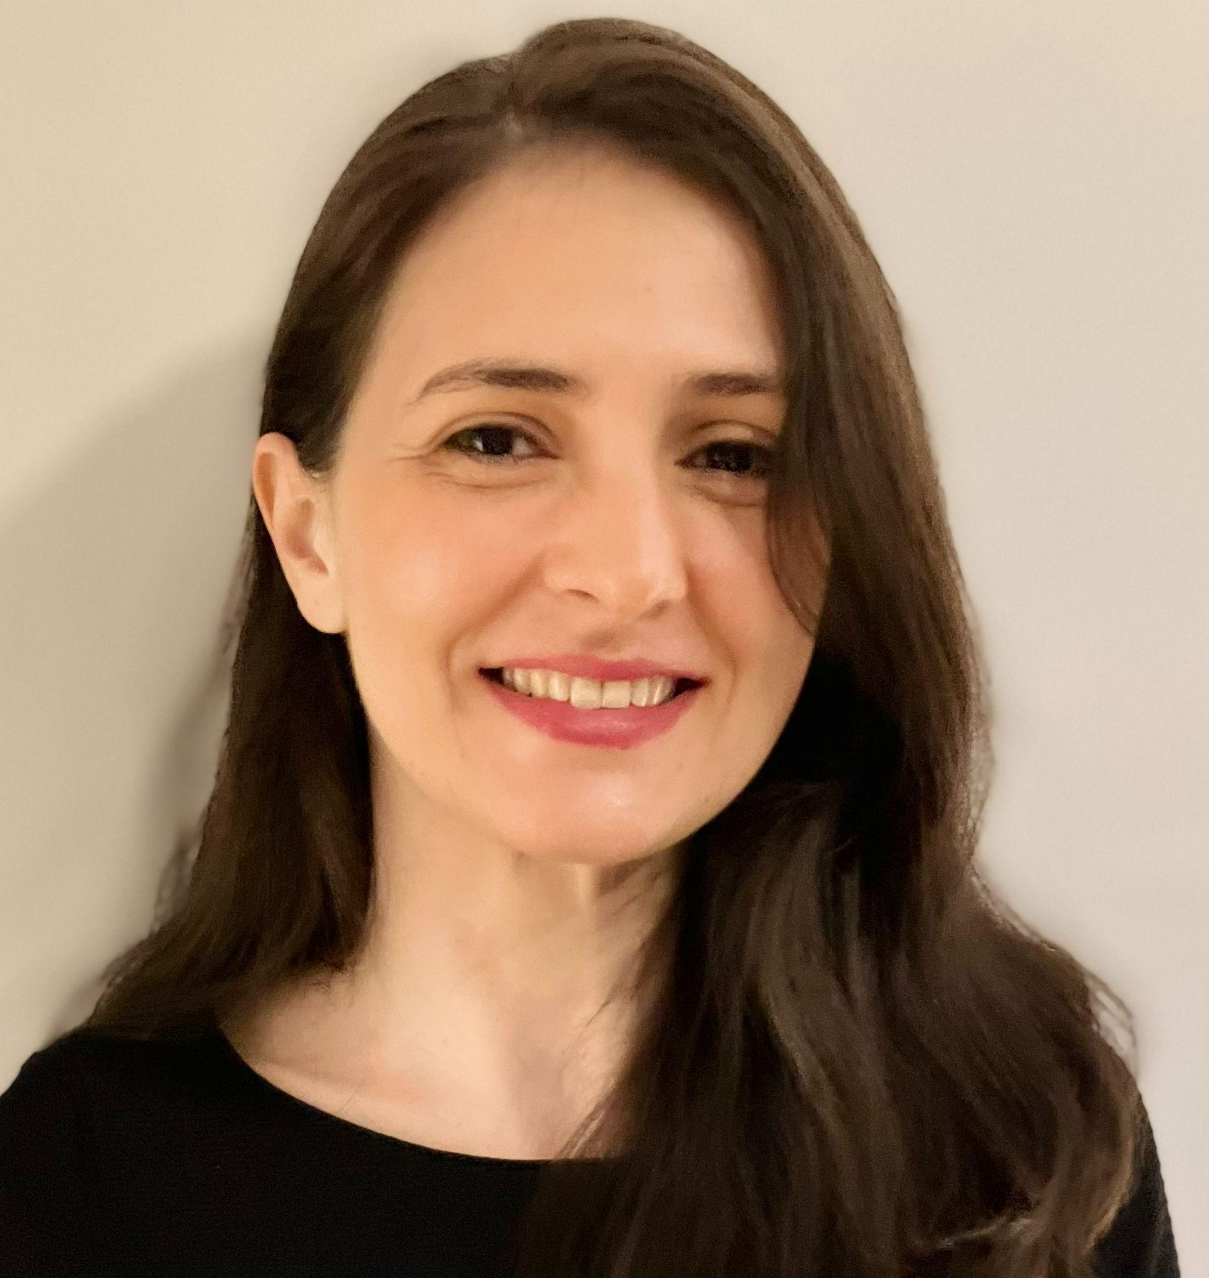

Course Team
Invited Speaker
Florin
Brad
Elena
Burceanu
Marius
Drăgoi
Florin
Gogianu
Andrei Nicolicioiu
Mila, Montreal, Canada
Emanuela
Haller
Elisabeta
Oneață
Ștefan Smeu
{fbrad, eburceanu, mdragoi, fgogianu, ehaller, eoneata, ssmeu}@bitdefender.com
andrei.nicolicioiu@gmail.com

Slide 3

Our Team
Team page: bit-ml.github.io

Slide 4
AI / ML Community
Bucharest
Bucharest Deep Learning
AI Reading Group @ Unibuc
Bucharest AI
AI Romania
Events
Romanian AI Days
20-21 September 2023 - Brașov, Romania
EEML Summer School
9-16 July 2023 - Košice, Slovakia

Slide 5
Eastern European Machine Learning Summer School
Deep Learning lectures
Tutorial sessions
Paper reading sessions
Poster sessions
Top speakers from: DeepMind, Google, McGill, Mila, Cambridge, Harvard, Oxford
Application
Extended abstract
Deadline: 31 March 2023
9-16 July 2023, Košice, Slovakia
https://www.eeml.eu/home
BONUS points for acceptance

Slide 6
AI / ML Community
Research Centers:
FMI: Marius Popescu, Bogdan Alexe, Radu Ionescu, Liviu Dinu et al.
UPB: Traian Rebedea, Marius Leordeanu et al.
IMAR: Marius Leordeanu et al.
UT (Cluj): Lucian Bușoniu et al.
Bitdefender: bit-ml.github.io team
Siemens (Brașov): Lucian Itu et al.
Industry:
Bitdefender: ML
Arnia: Outsourcing CV, NLP
Sparktech: Outsourcing CV, NLP
Xperi: CV
Siemens (Brasov): Medical CV, ML
BOSCH (Cluj): Autonomous driving
Continental (Timișoara): Autonomous driving
Adobe: NLP, CV

Slide 7
Administrative

Slide 8
Program
Lectures
Each Wednesday: 18:00 - 20:00 (Room 216)
3 speed tests
5 minutes
1-2 short questions
Labs
Each Wednesday: 16:00 - 18:00 (Room 303)
Course Materials
https://drive.google.com/drive/folders/1FvxkNCCJ_2hBmA1GmaCXvkmS5YgnWtxb?usp=sharing

Slide 9
Assignments and Projects
2 Assignments (PyTorch)
Related to the lab content
Submission deadline: 2 or 3 weeks after publishing
penalties for delays
Both of them will be presented in Week 9
1 Project (PyTorch)
Teams of 2 members
Subjects will be proposed in Week 4
Each student should choose a subject until Week 6
Will be presented in Week 10 - Poster Session

Slide 10
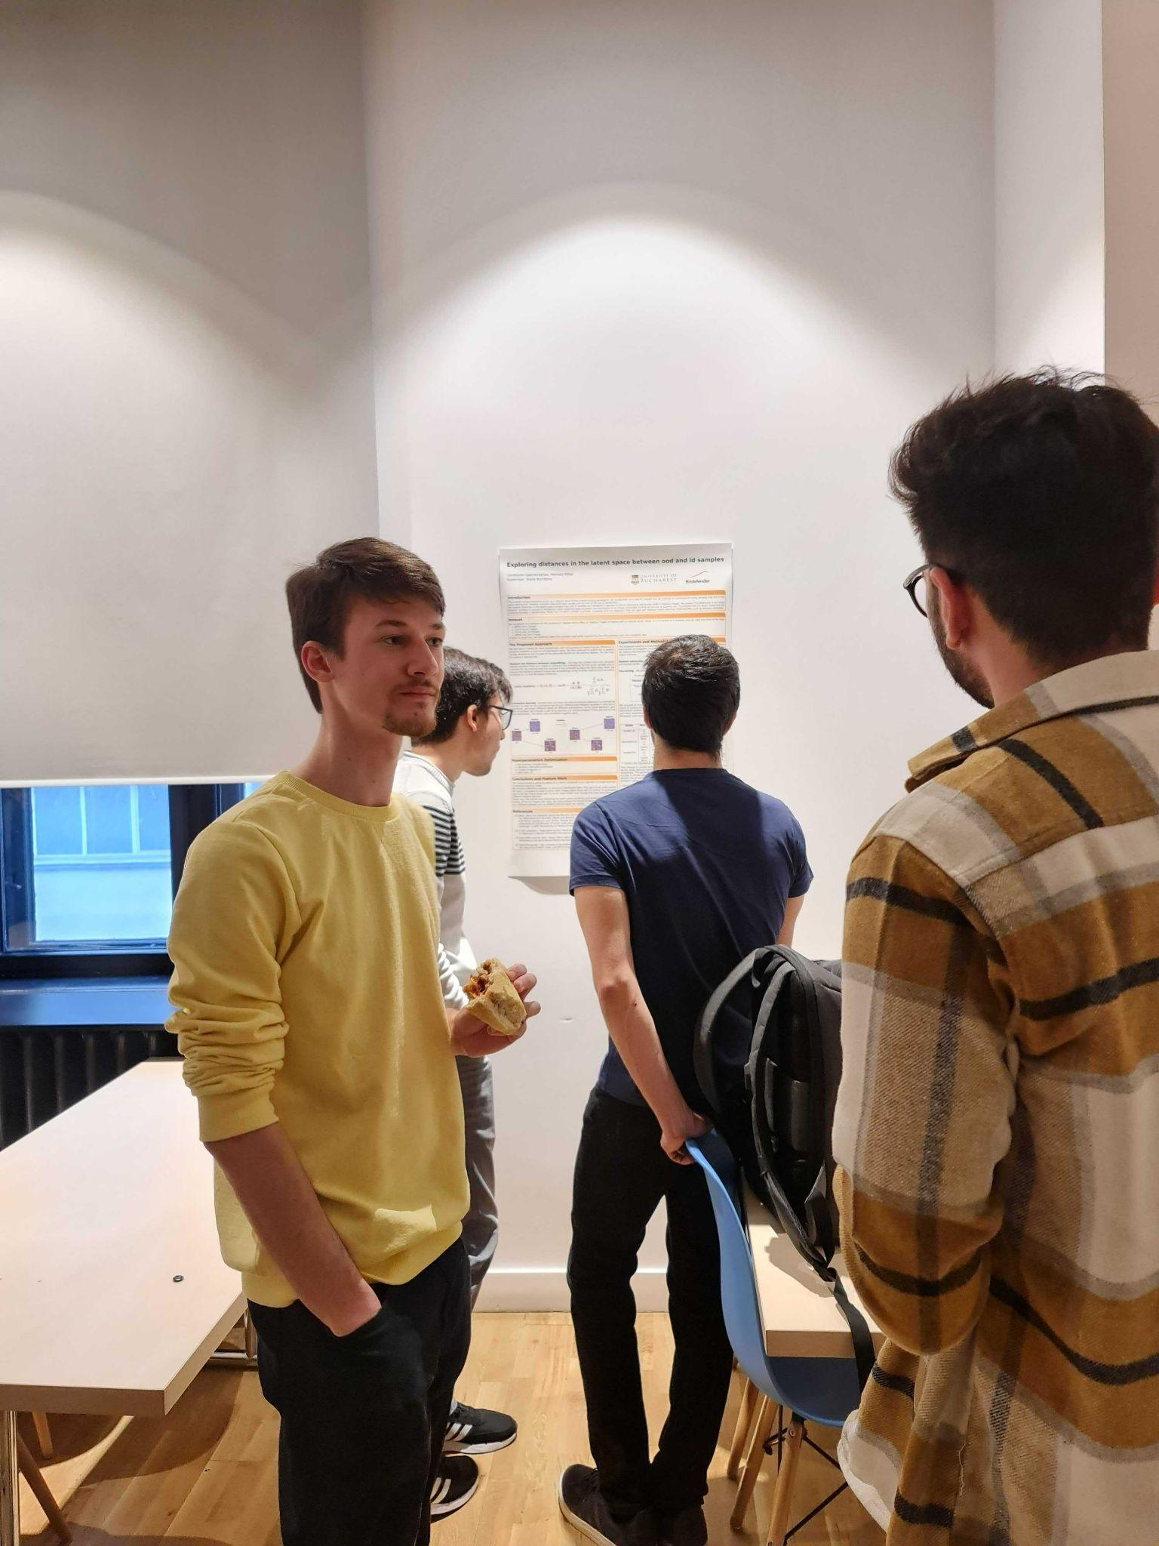
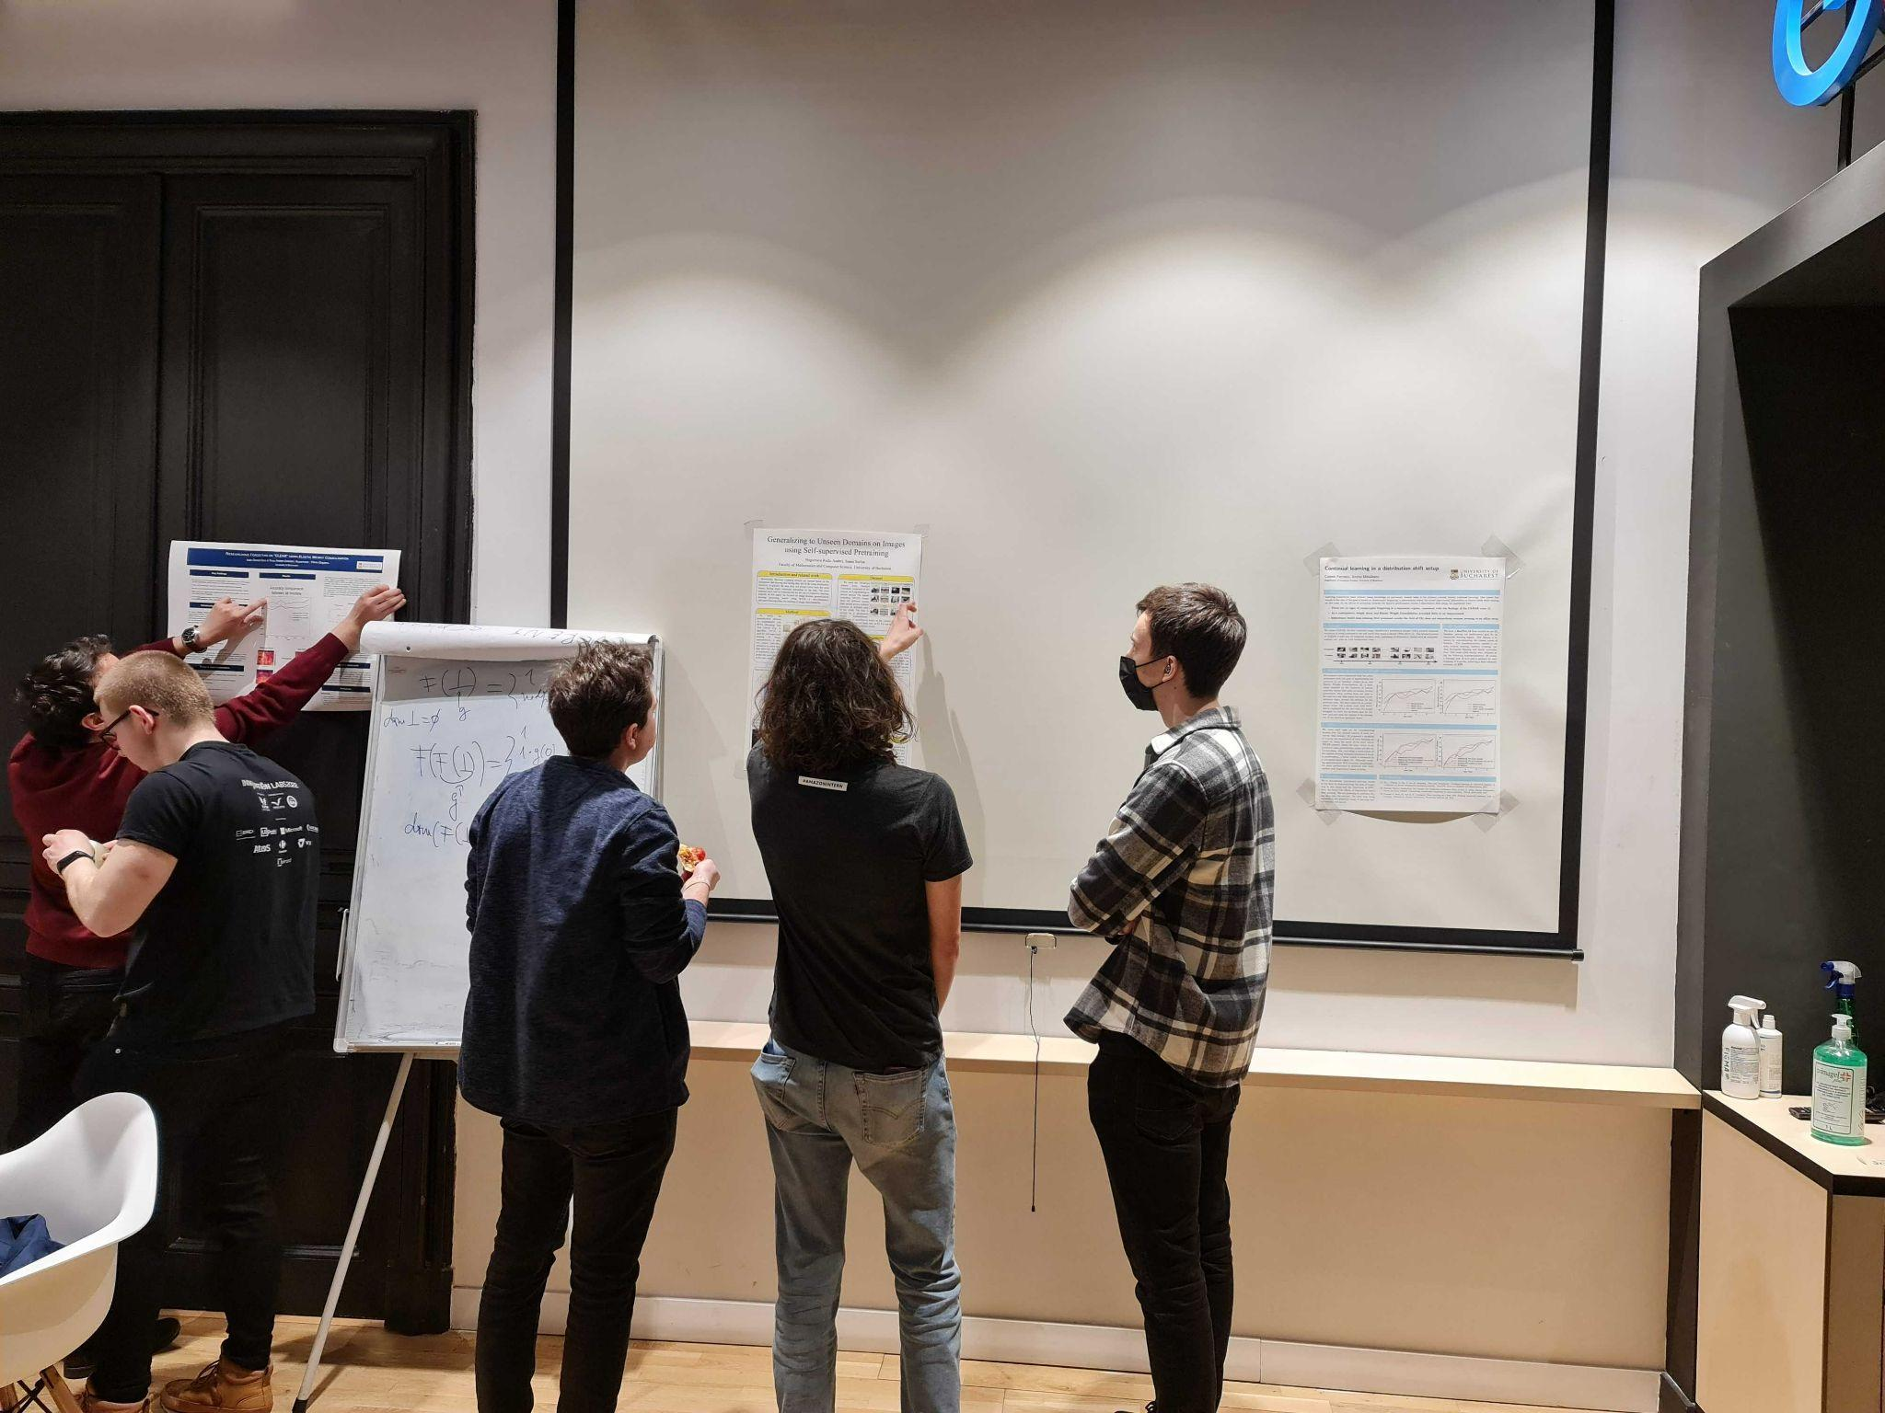
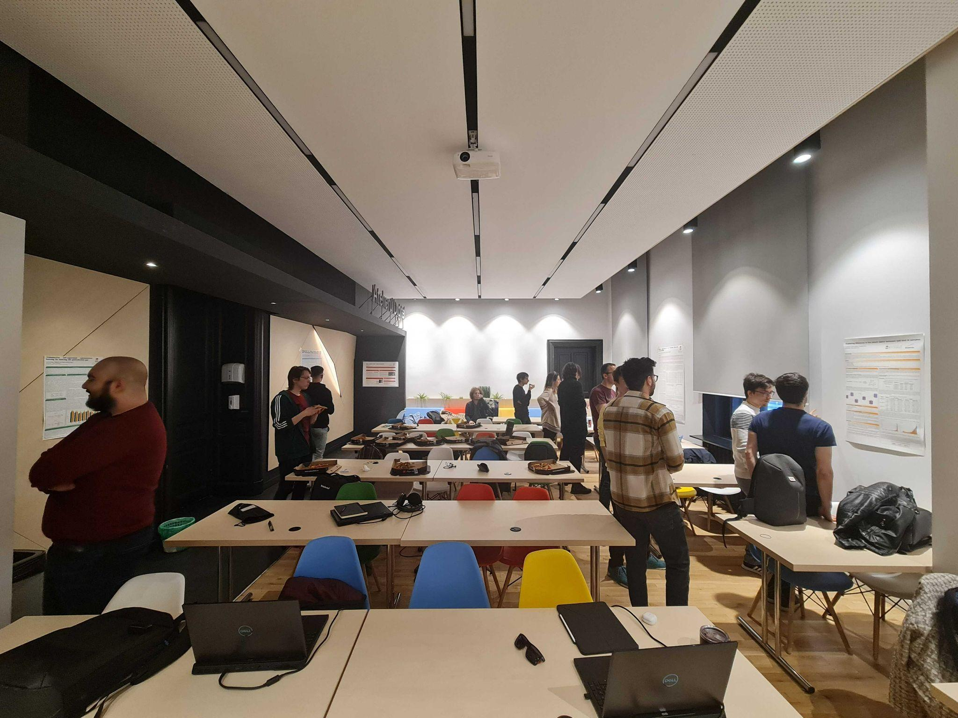
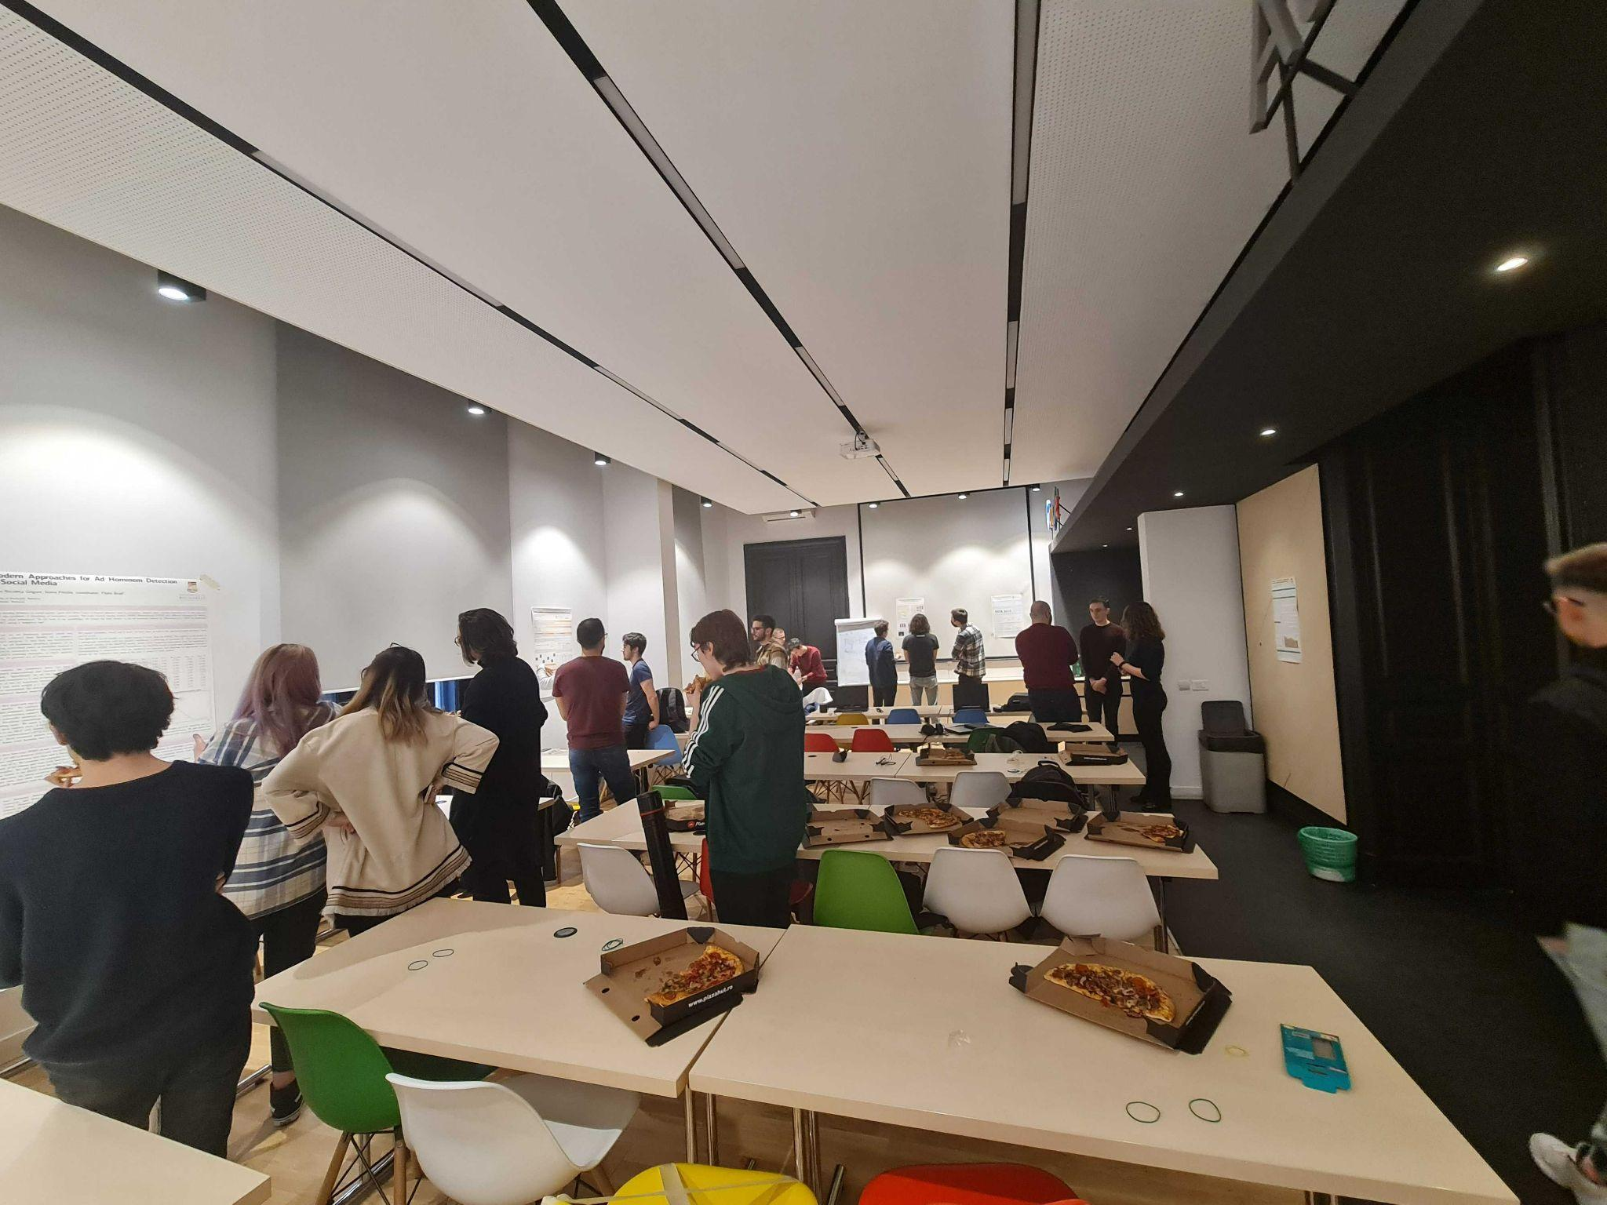
Poster Session

Slide 11
Course Structure
Week | Lecture | Speed Test | Laboratory | Event | Deadline
1 | Introduction to Deep Learning |  | PyTorch and Tensors
2 | Neural Networks |  | Neural Networks
3 | Optimization |  | Training and Optimization | Assignment 1 out
4 | Debugging Neural Networks | Test 1 | Debugging | Project proposals
5 | Convolutional Neural Networks |  | ConvNets (1) | Assignment 2 out | Assignment 1
6 | Computer Vision Applications |  | ConvNets (2) |  | Project selection EEML- March 31
7 | Sequential Models | Test 2 | Sequential Models
8 | Natural Language Processing Applications |  | NLP Applications |  | Assignment 2
9 | Unsupervised Learning | Test 3 | Assignments Evaluation
10 | Project Evaluation (Poster Session) |  | Project Evaluation |  | Project

Slide 12
Grading
 |  | Requirements
Assignment 1 | 2 points | 50% (2.5 points)
Assignment 2 | 2 points
3 x Speed Tests | 1 point
[BONUS] Good answers / questions during lectures and labs | max 2 points
Project | 5 points | 50% (2.5 points)
[BONUS] Good interventions / questions during the poster session | max 1 point

Slide 13
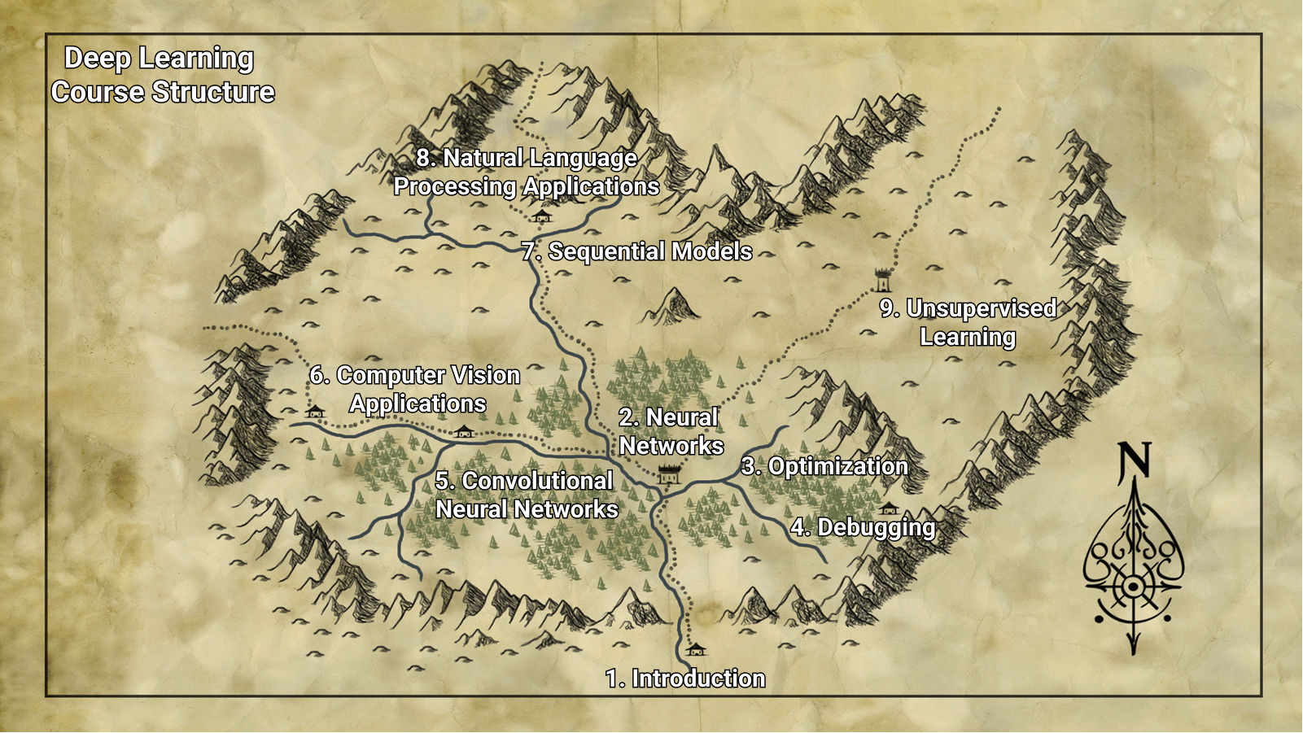

Slide 14
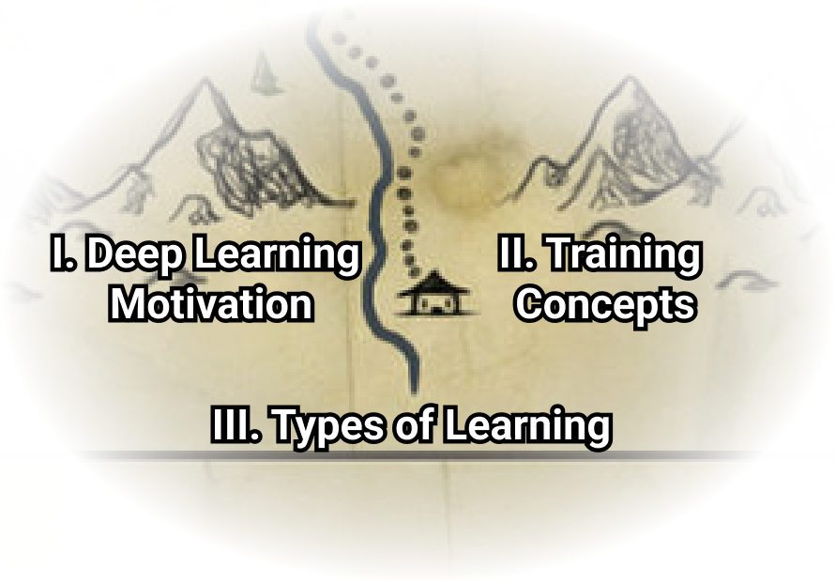
Introduction - Lecture Overview

Slide 15
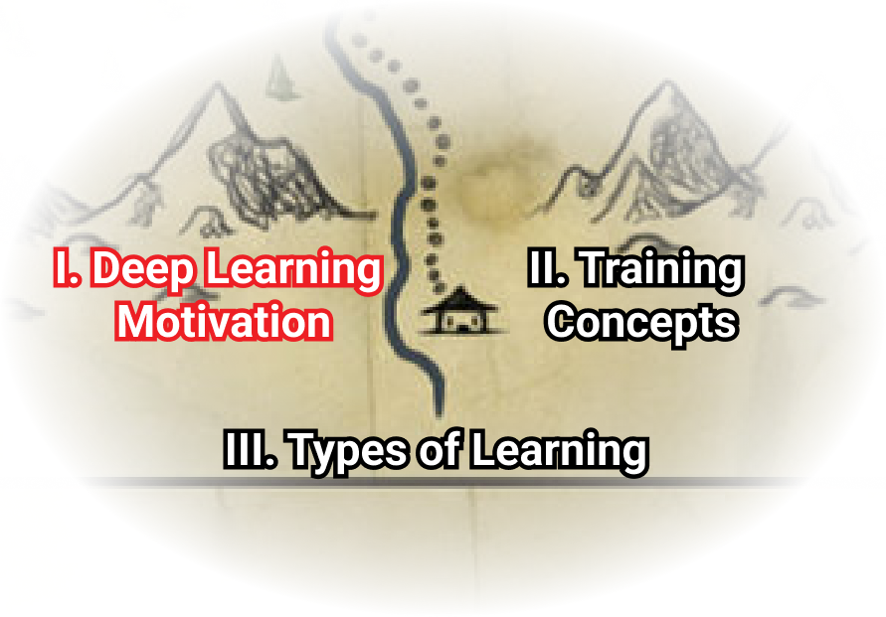
Deep Learning Motivation

Slide 16
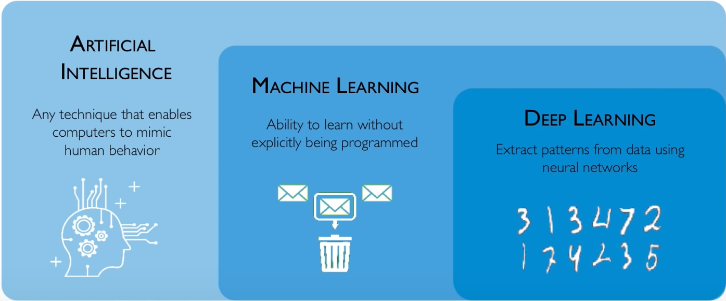
Artificial Intelligence

Slide 17
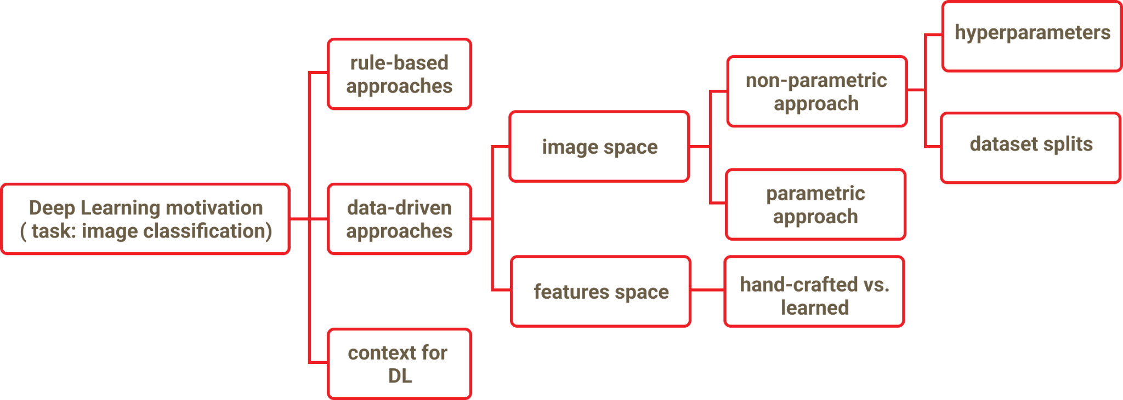
Deep Learning Motivation

Slide 18
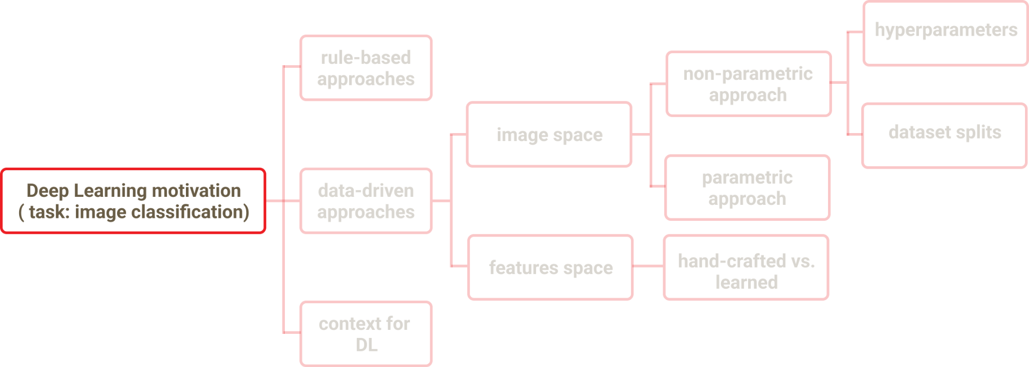
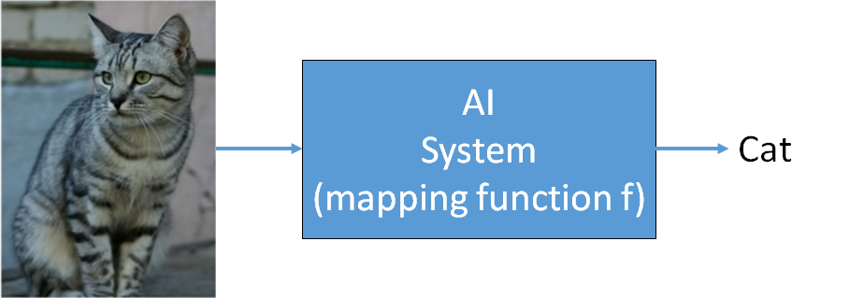
Task: Image Classification
Classify an image according to its visual content
Consider a discrete set of labels
e.g. {dog, airplane, car, cat}

Slide 19
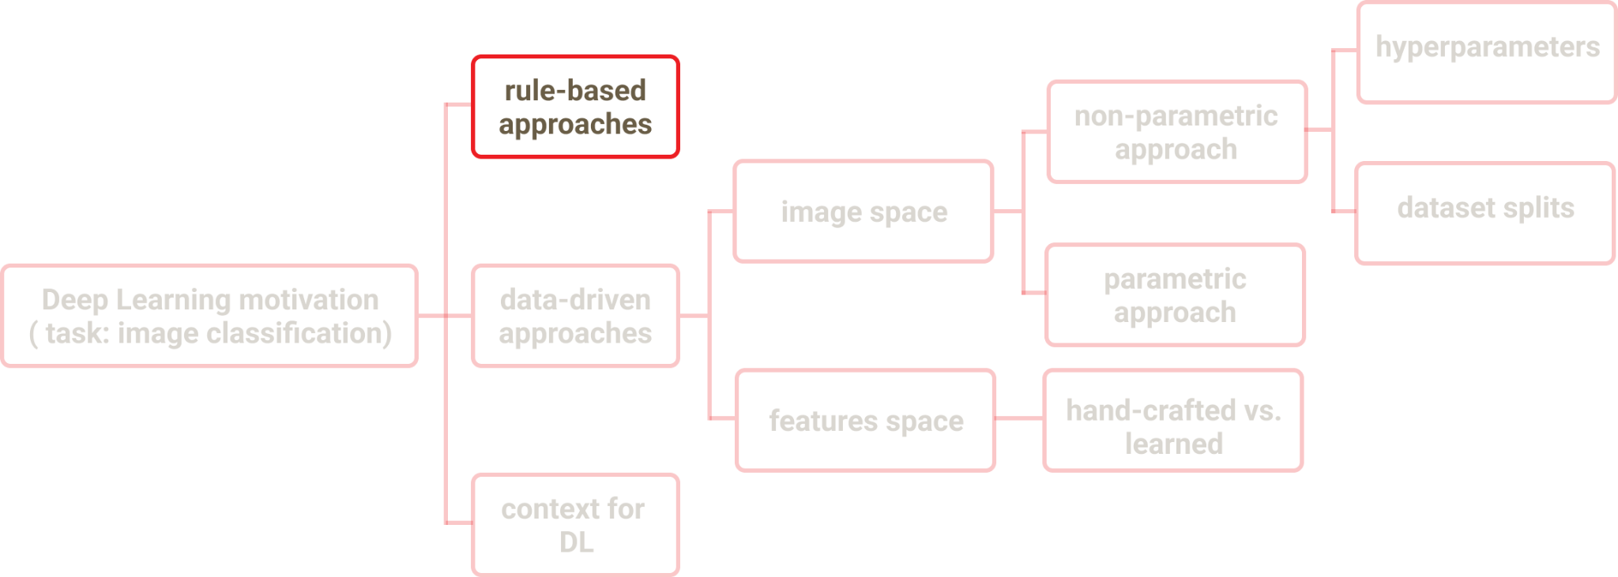
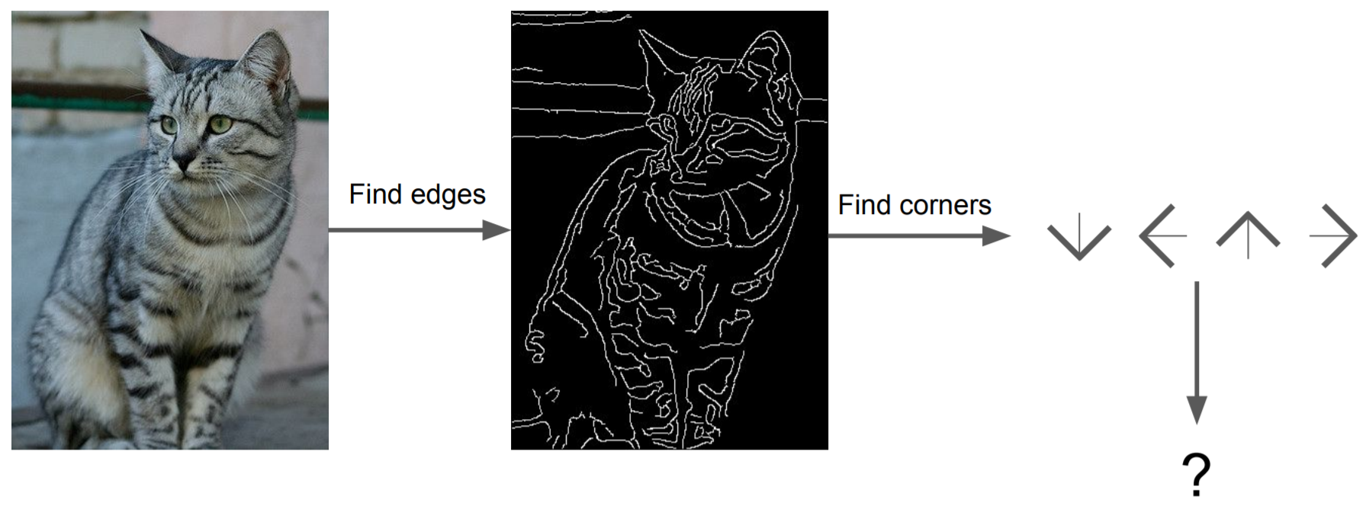
Rule-Based Approach
Hand crafted features and rules

Slide 20
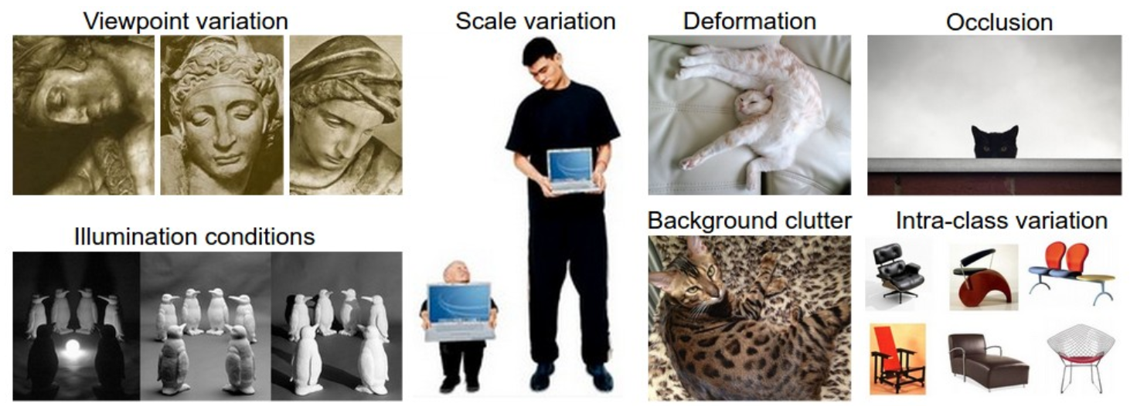
Challenges

Slide 21
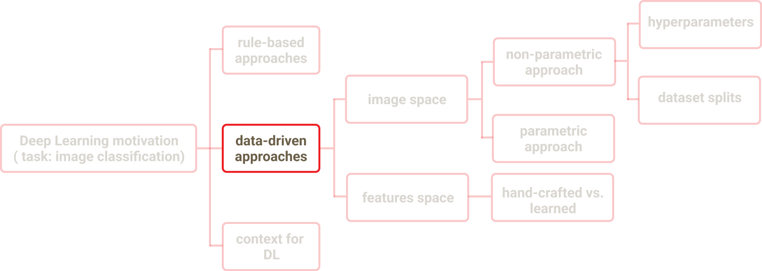
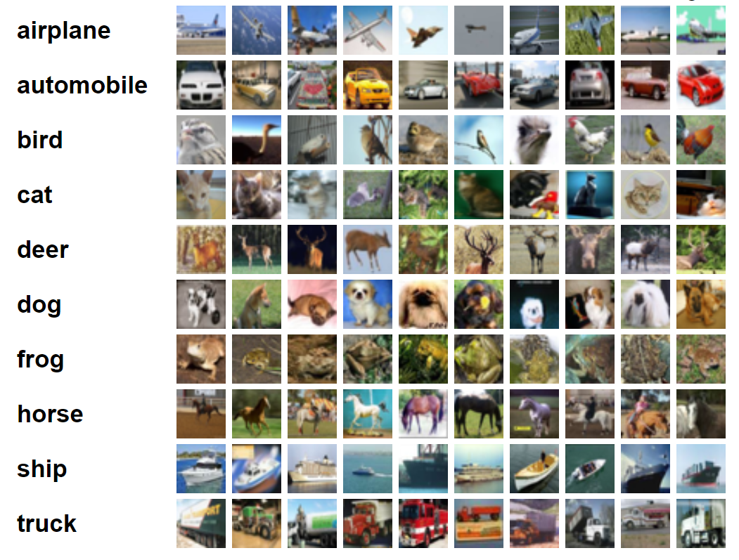
Data-Driven Approach
Dataset
With images and associated labels
CIFAR-10
10 classes
60 000 examples
32 x 32 x 3
CIFAR-10

Slide 22
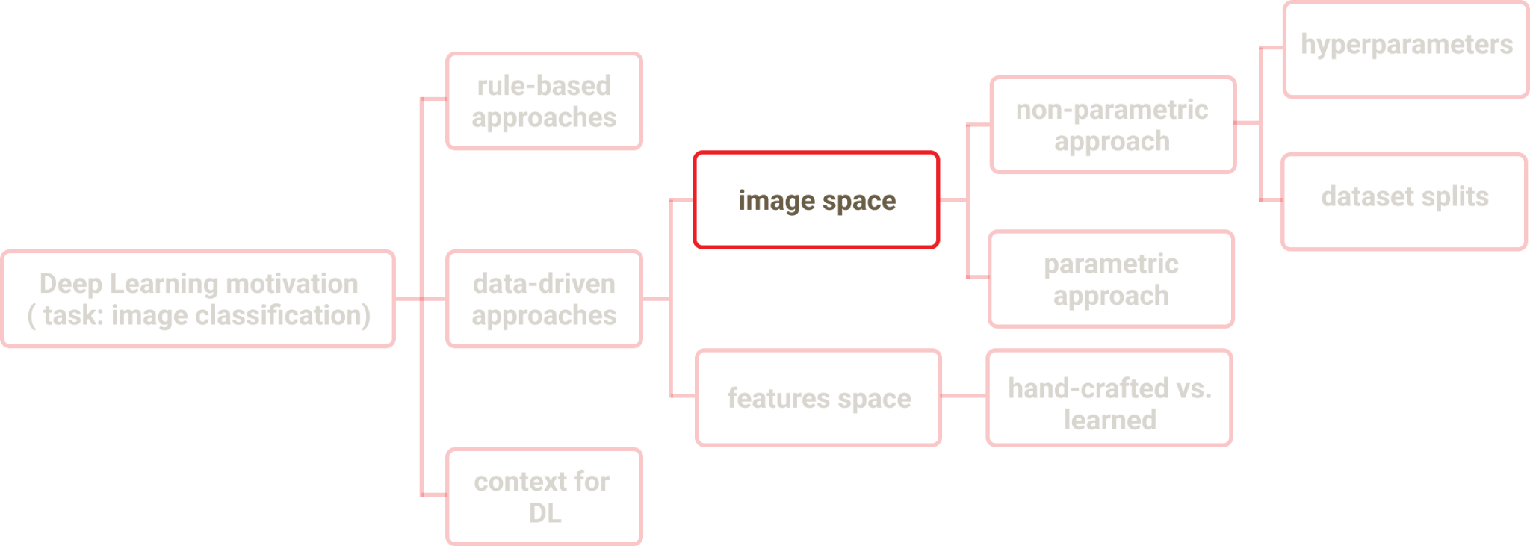
Image Space
CIFAR-10

Slide 23
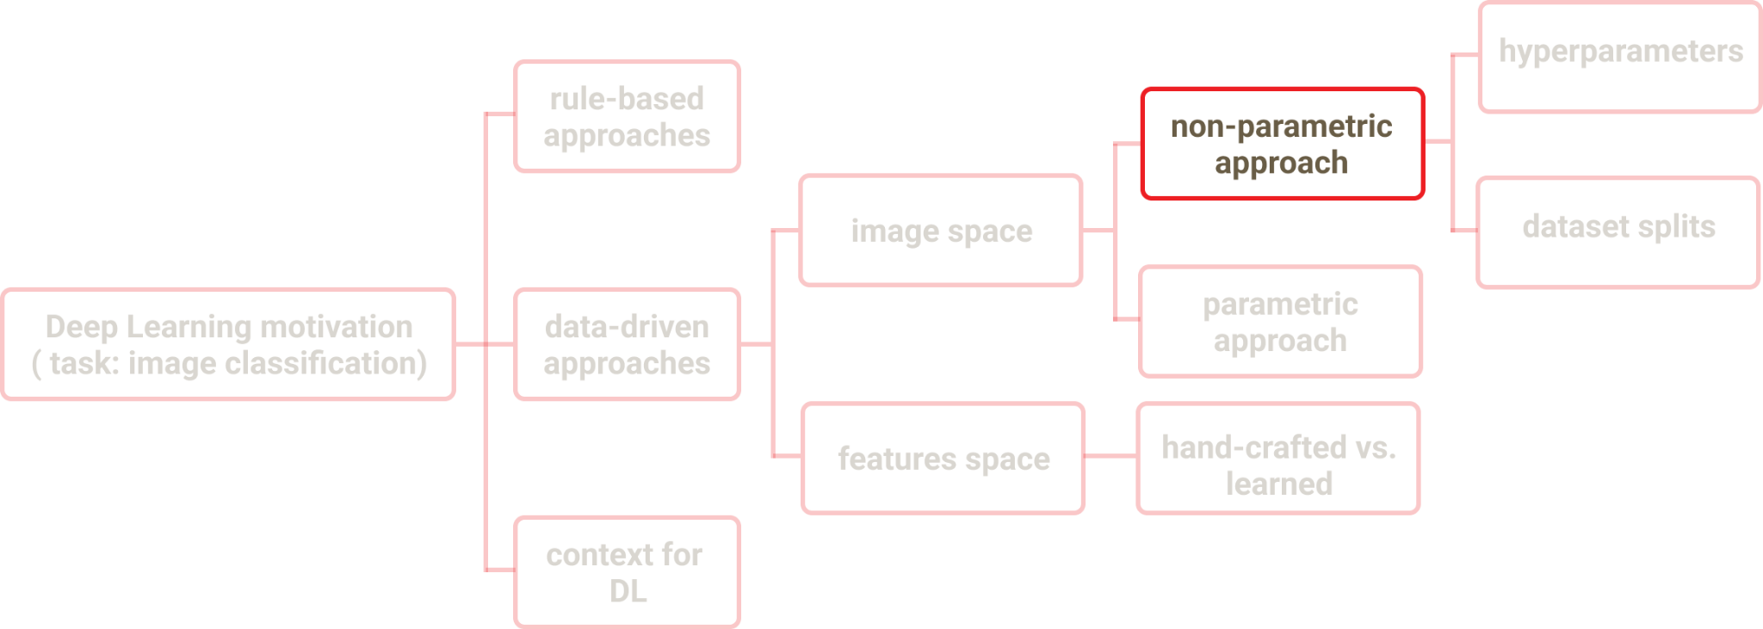
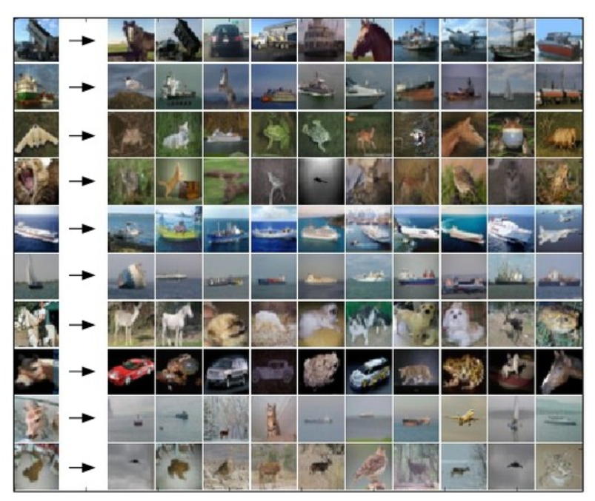
Image Space
Non-Parametric Approach
K-Nearest Neighbor Classifier
Memorize all examples and corresponding labels
Predict label of top K most similar examples
Define distance between two images
CS231, Stanford University

Slide 24
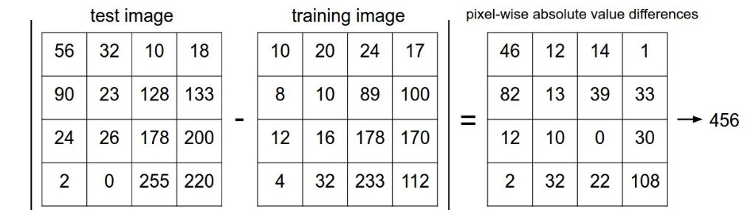
Distance metric
CS231, Stanford University

Slide 25
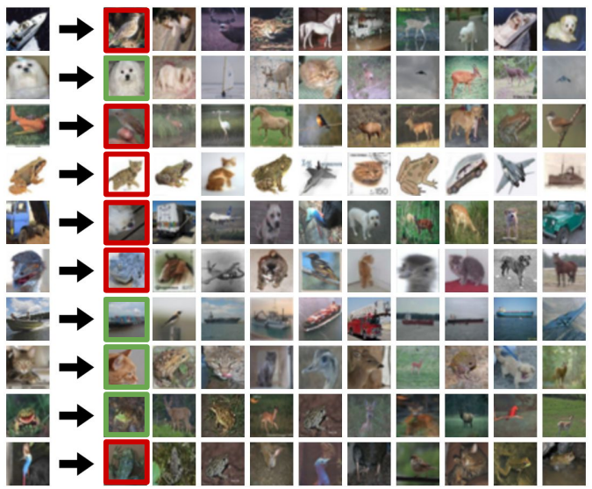
K-Nearest Neighbor Classifier
K=1
CS231, Stanford University

Slide 26
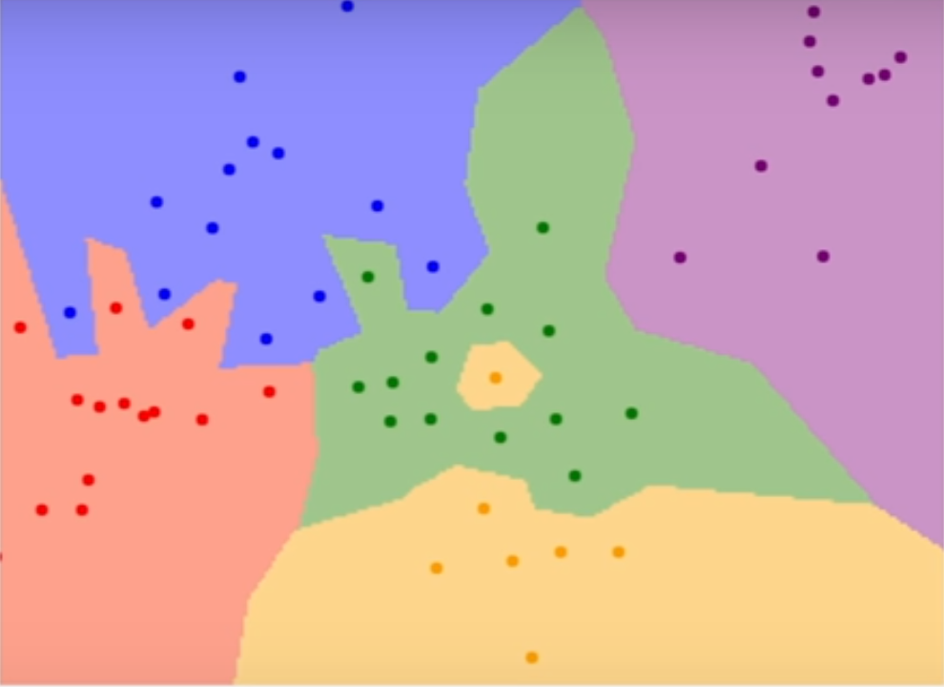
K-Nearest Neighbor Classifier
Decision regions
K=1
CS231, Stanford University

Slide 27
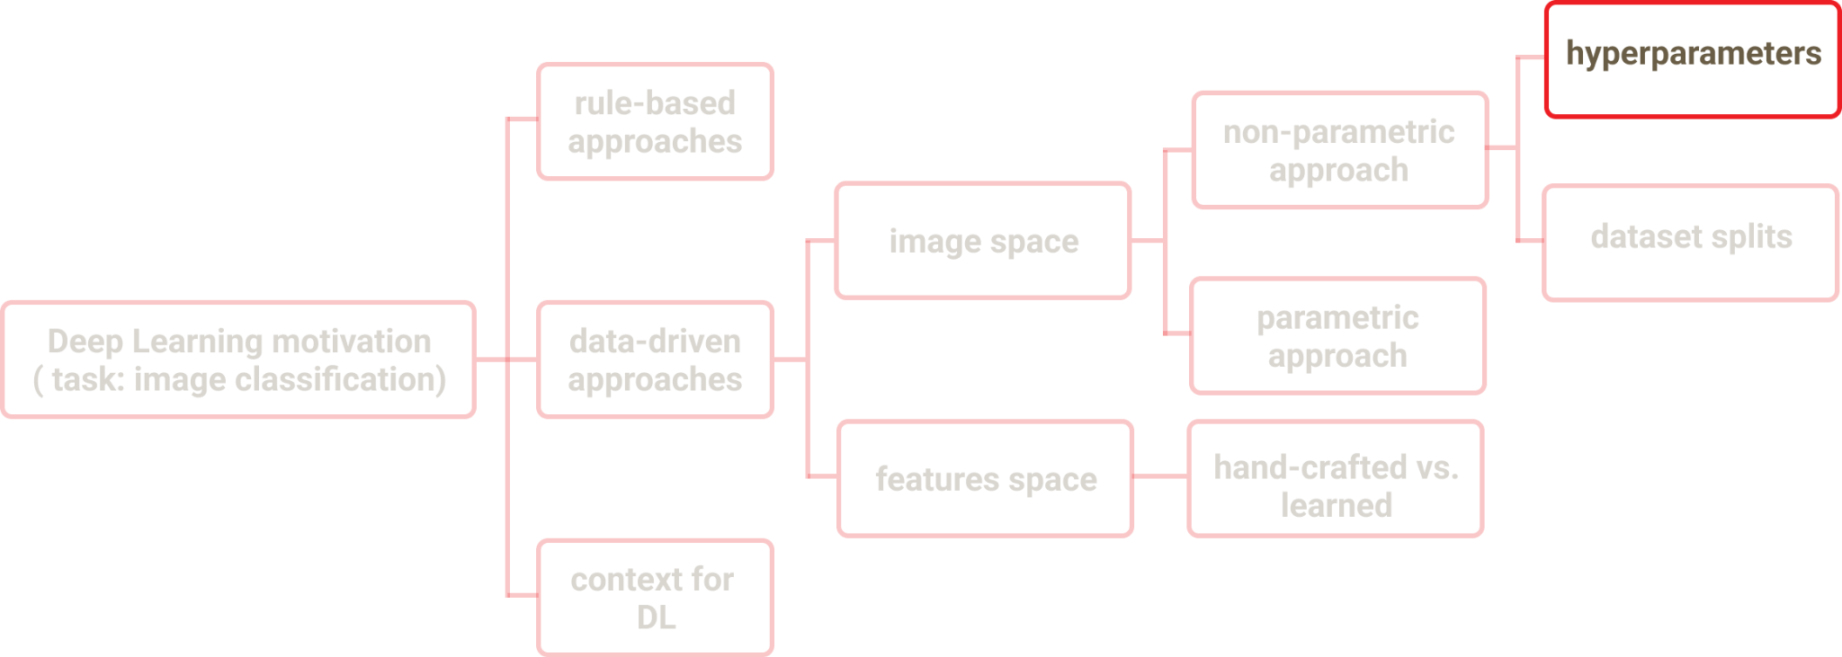
K-Nearest Neighbor Classifier
Hyperparameters
K
Distance metric

Slide 28
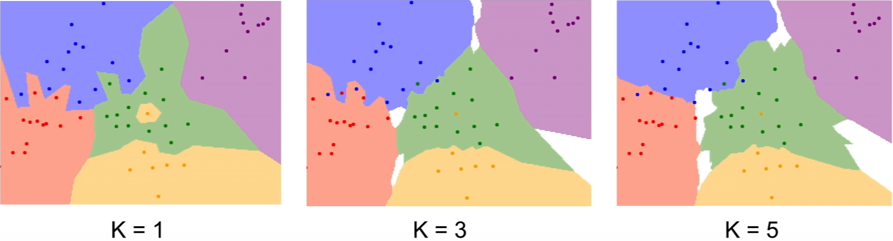
Hyperparameters: K
CS231, Stanford University

Slide 29
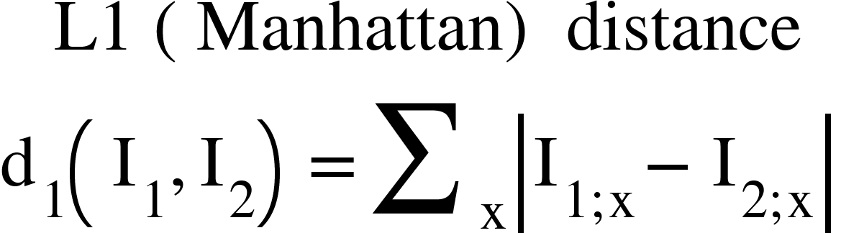
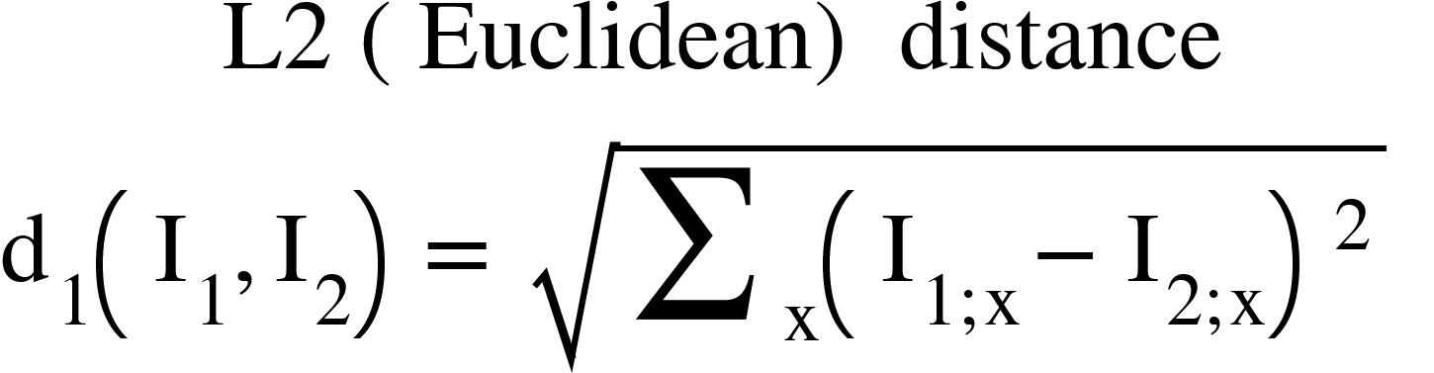
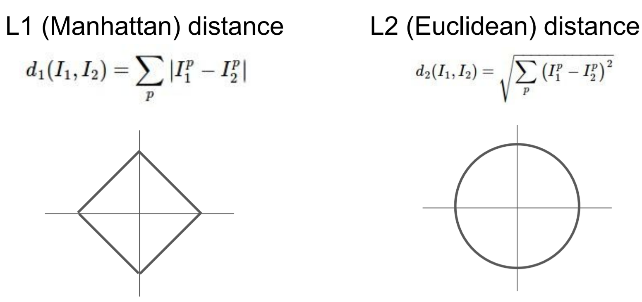
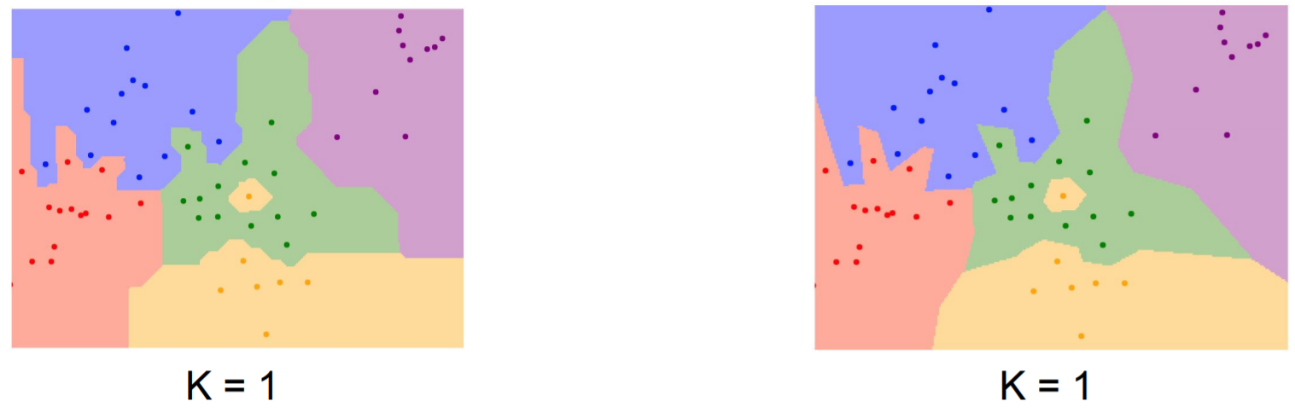
Hyperparameters: distance metric
CS231, Stanford University

Slide 30
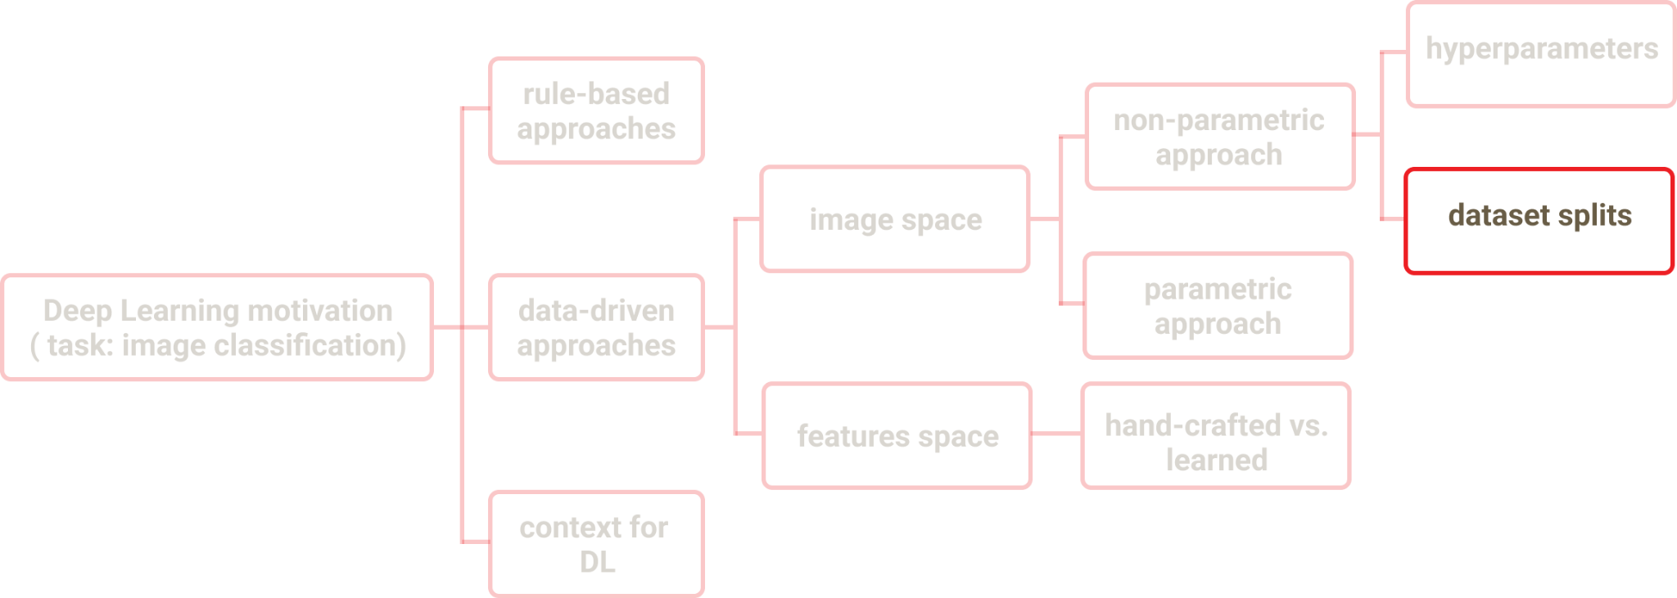
Dataset splits
Only train data

Slide 31
Dataset splits
Only train data
K=1 - works best for training data

Slide 32
Dataset splits
Only train data
K=1 - works best for training data
Train data & Test data

Slide 33
Dataset splits
Only train data
K=1 - works best for training data
Train data & Test data
No intuition on how the algorithm will perform on new data

Slide 34
Dataset splits
Only train data
K=1 - works best for training data
Train data & Test data
No intuition on how the algorithm will perform on new data
Train data & Validation data & Test data

Slide 35
Dataset splits
Only train data
K=1 - works best for training data
Train data & Test data
No intuition on how the algorithm will perform on new data
Train data & Validation data & Test data

Slide 36
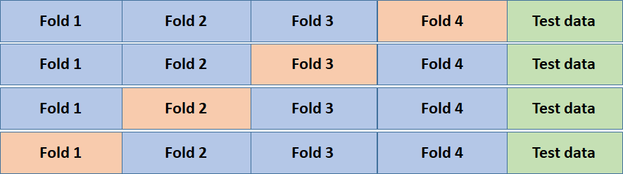
Dataset splits
Only train data
K=1 - works best for training data
Train data & Test data
No intuition on how the algorithm will perform on new data
Train data & Validation data & Test data
Cross Validation

Slide 37
Image Space K-Nearest Neighbor
Issues ?
CS231, Stanford University

Slide 38
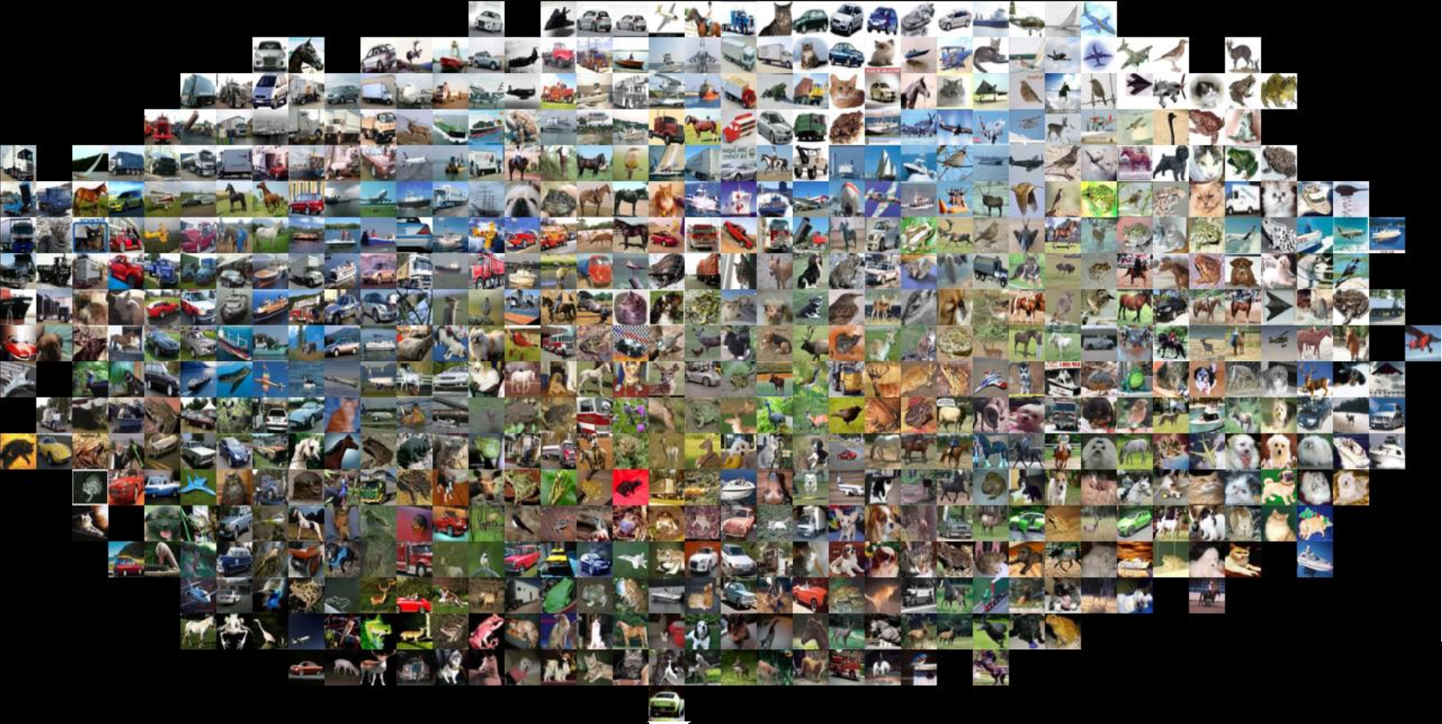
Image Space K-Nearest Neighbor
Issues
Pixel-wise distances are not informative
Train: O(1)
Test: O(n)
CS231, Stanford University

Slide 39
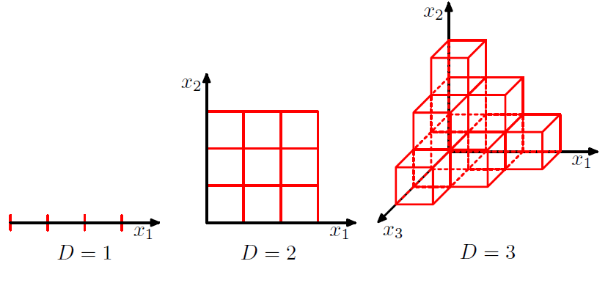
Image Space K-Nearest Neighbor
Issues
Curse of dimensionality

Slide 40
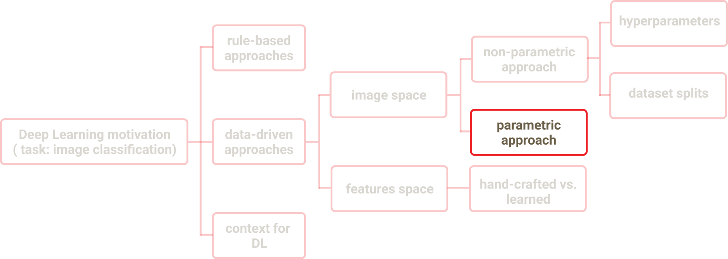
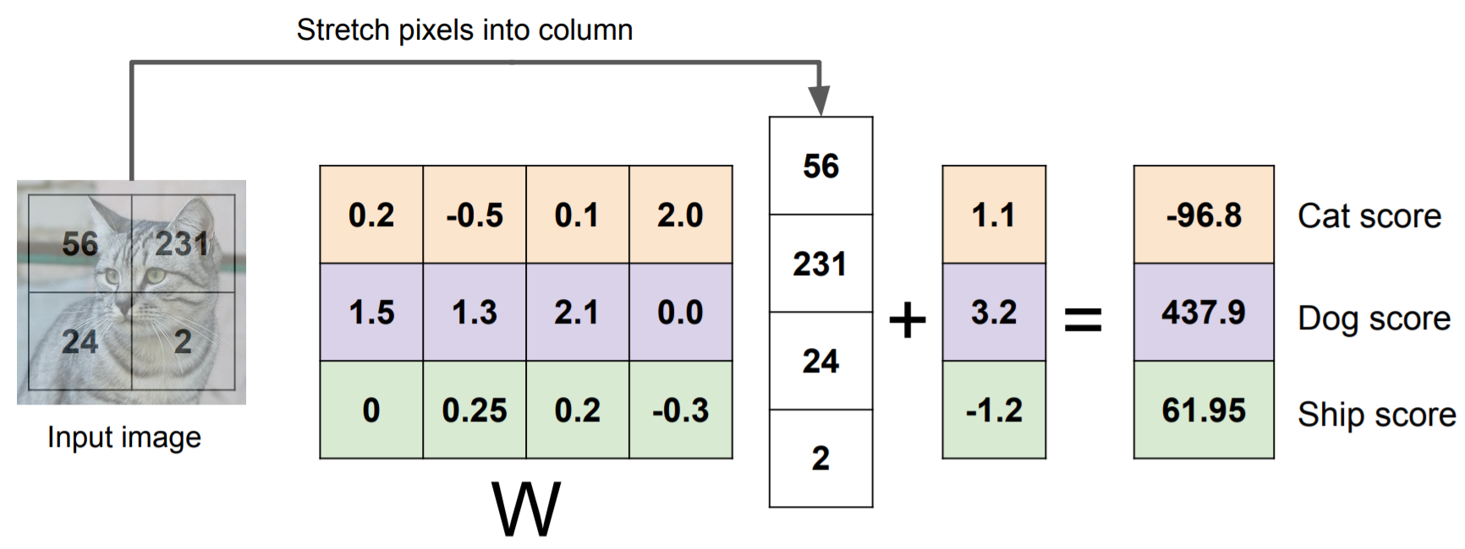
Image Space Parametric approach - Linear Classifier
f(x,W)=Wx + b, W - parameters to be learned
CS231, Stanford University

Slide 41
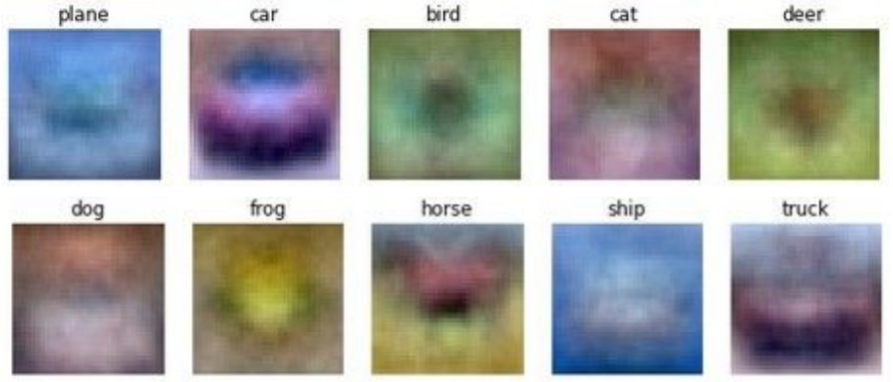
Linear Classifier - Interpretation
CS231, Stanford University

Slide 42
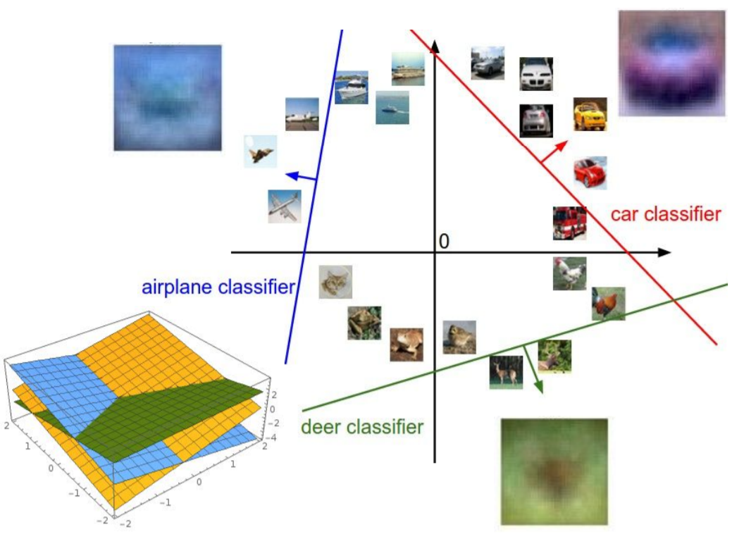
Linear Classifier - Interpretation
CS231, Stanford University

Slide 43
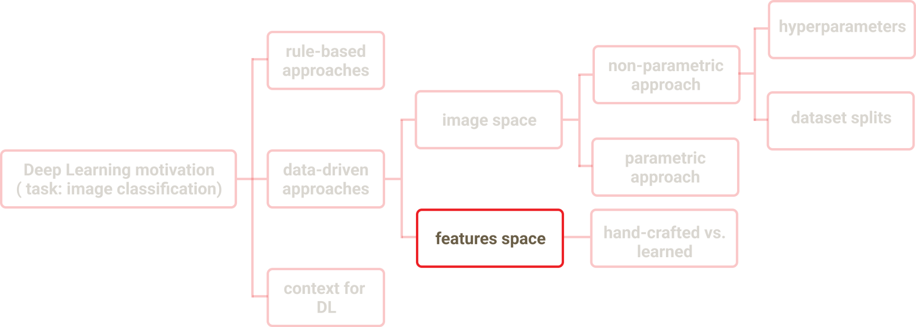
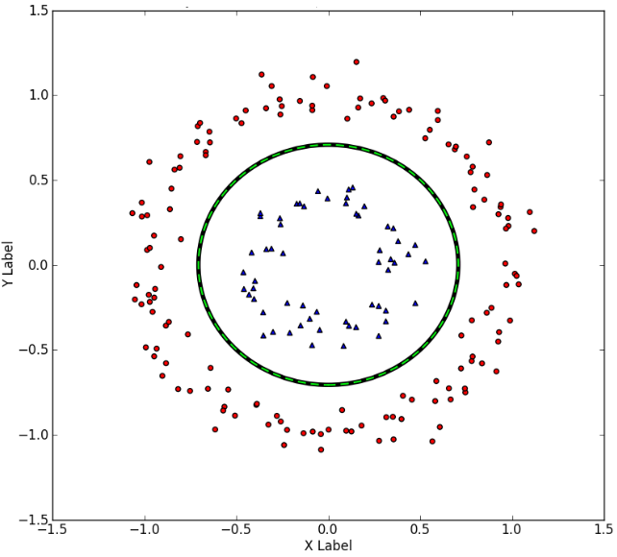
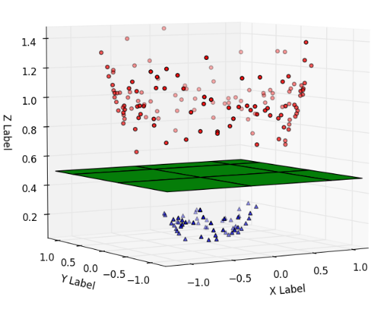
Features Space - Motivation
z=x²+y²
CS231, Stanford University

Slide 44
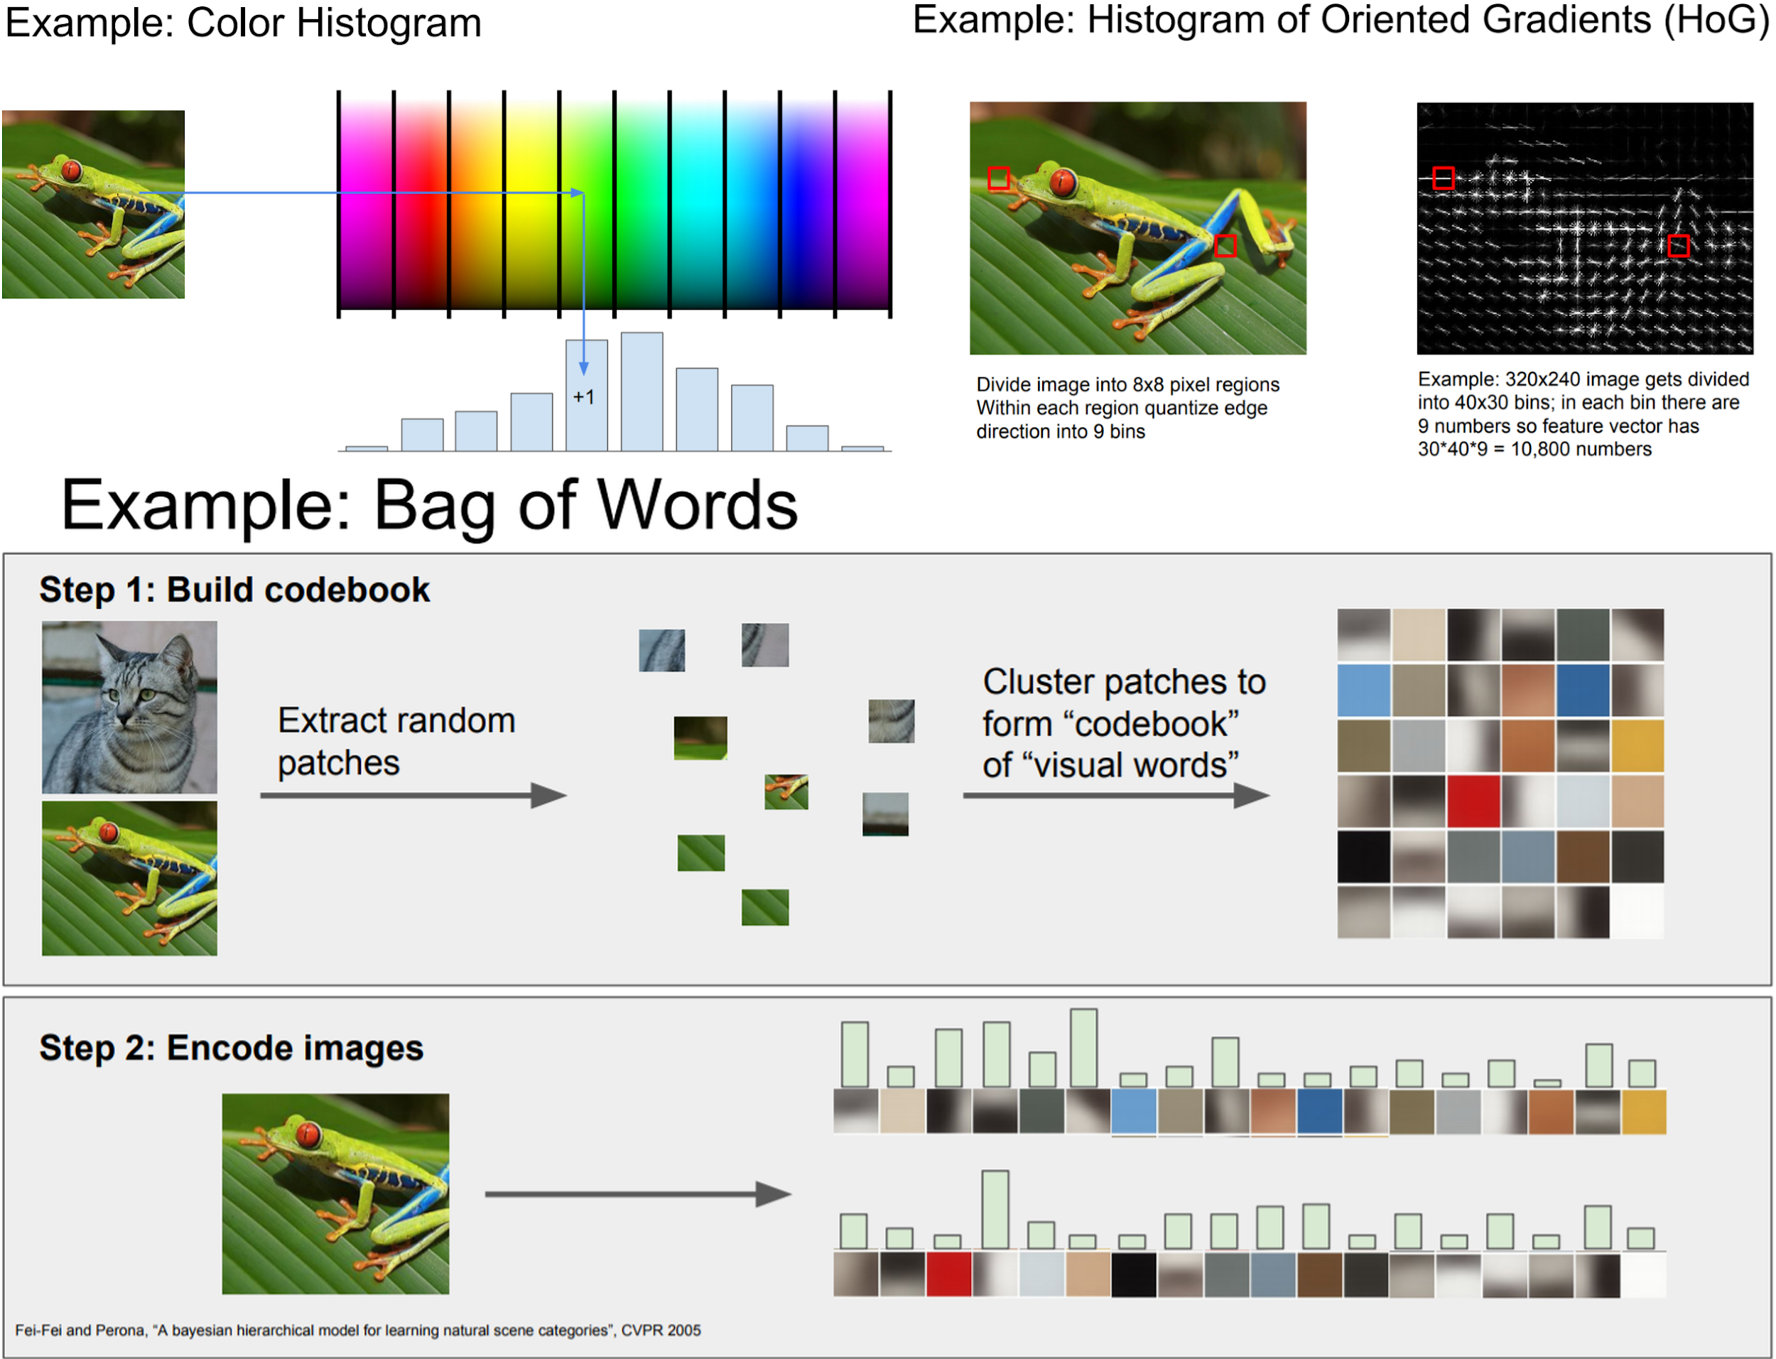
Image Space ⟶ Features Space
Hand-crafted
CS231, Stanford University

Slide 45
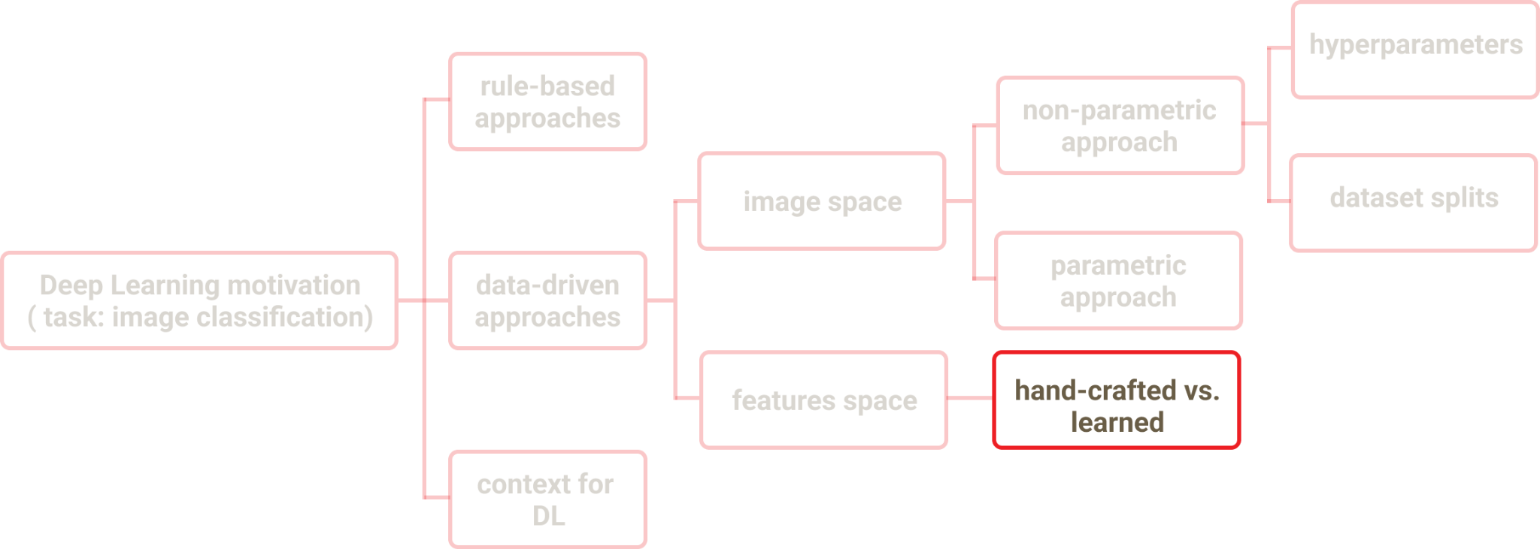
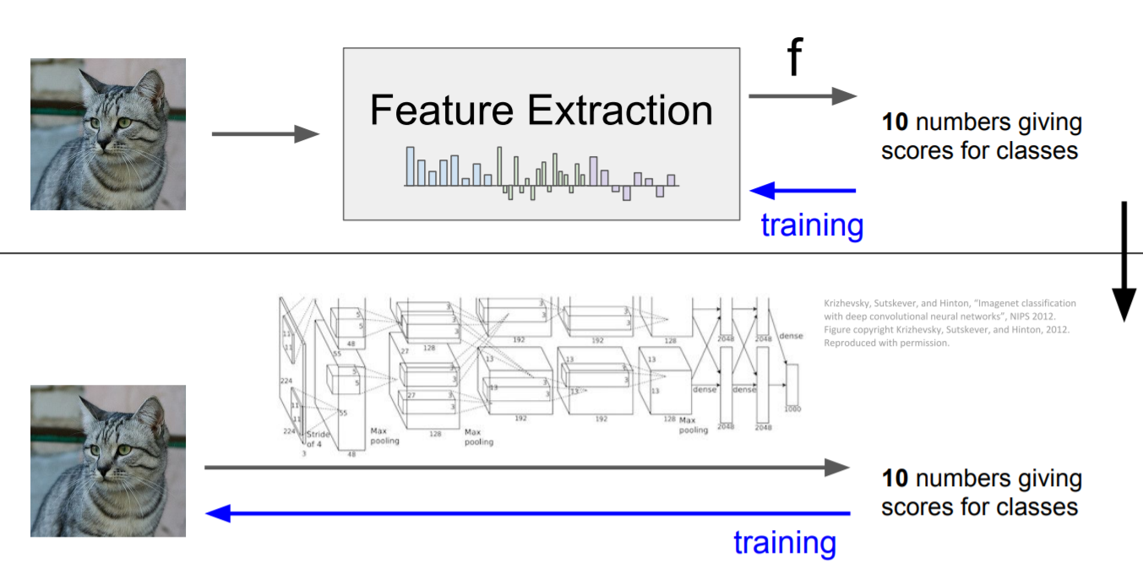
Hand-Crafted vs. Learned Features
CS231, Stanford University

Slide 46
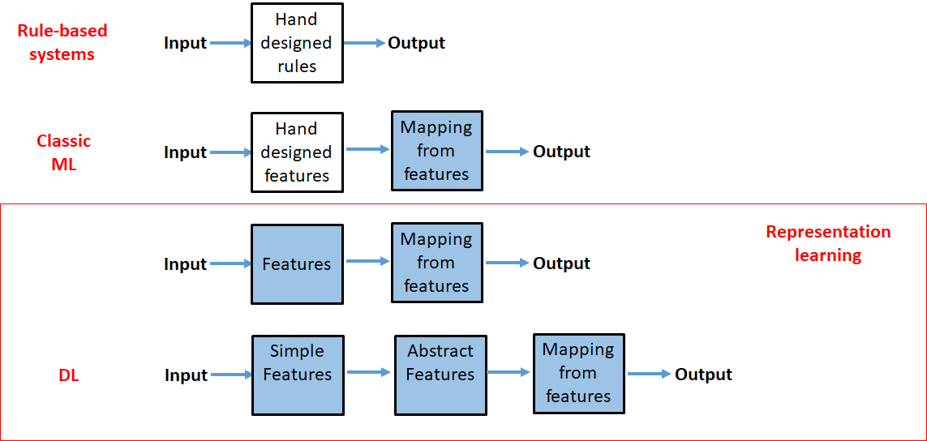
Hand-Crafted vs. Learned Features

Slide 47
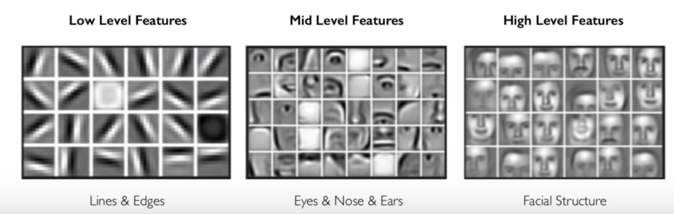
Why Deep Learning
Learn underlying features directly from data
CS231, Stanford University

Slide 48
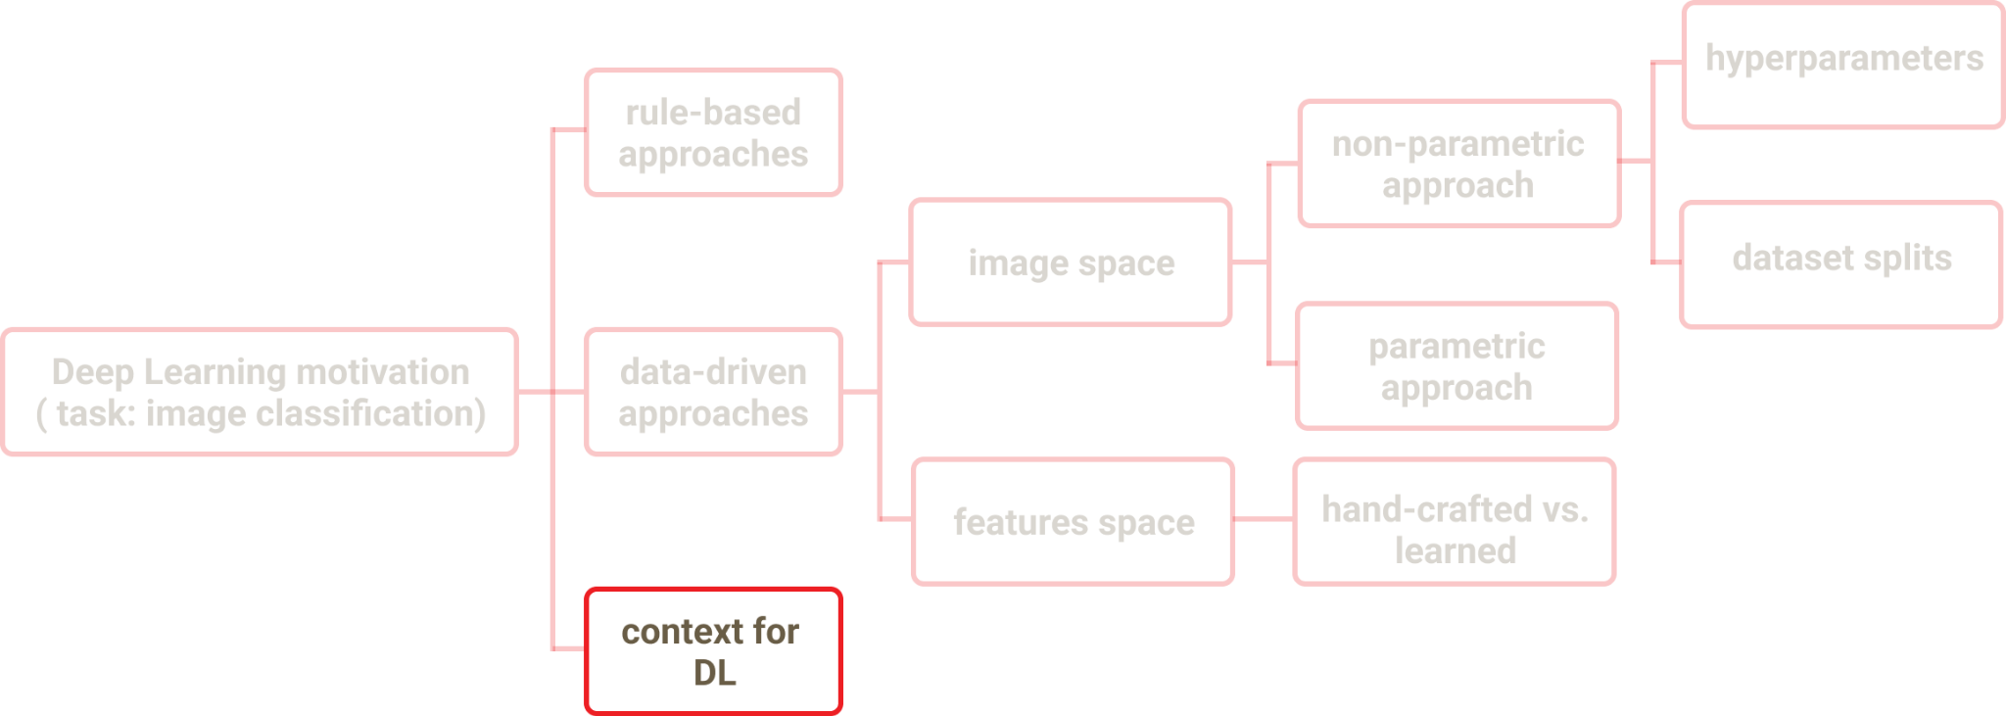
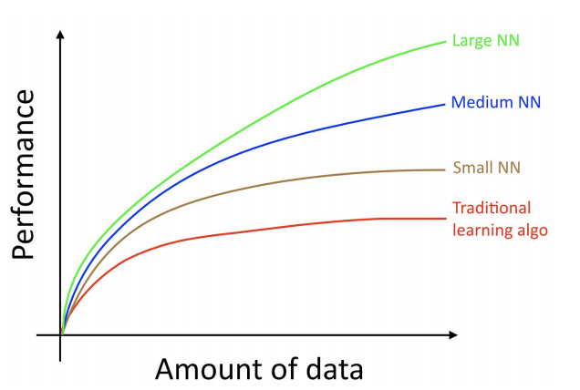
Context for Deep Learning
Big data
Larger datasets
Hardware
GPUs
Massively parallelizable algorithms
Deep Learning Frameworks
PyTorch
Tensorflow
Second Layer Libs:
Keras - over Tensorflow
Fast.ai - over PyTorch

Slide 49
Recap - Deep Learning Motivation

Slide 50

II. Training Concepts

Slide 51

Training Concepts

Slide 52






Task: Curve-Fitting
Training set:
Data generating process:
Underlying regularity which we wish to learn
Individual observations are corrupted by random noise
Goal: predict for some new
Regression problem
Pattern Recognition, Christopher M. Bishop

Slide 53




Polynomial Curve Fitting
Fit the data using a polynomial function
- order of the polynomial - model complexity
- parameters to be learned
- nonlinear function of
- linear function of the parameters
Pattern Recognition, Christopher M. Bishop

Slide 54



Loss Function
Sum of squares error
Pattern Recognition, Christopher M. Bishop

Slide 55



Closed Form Solution
Goal is to minimize
quadratic function of the parameters
Derivative w.r.t. parameters is linear in the parameters
Unique solution can be found in closed form

Slide 56


Model Complexity
Pattern Recognition, Christopher M. Bishop

Slide 57



Model Complexity
Pattern Recognition, Christopher M. Bishop

Slide 58


Increase training set
M=9
Pattern Recognition, Christopher M. Bishop

Slide 59



Regularization
Pattern Recognition, Christopher M. Bishop

Slide 60


Regularization
Pattern Recognition, Christopher M. Bishop

Slide 61


Bias and Variance
Algorithm’s Bias
Error on training set
Algorithm’s Variance
Performance decrease between train set and test set
High Variance => Overfitting
High Bias => Underfitting
Bias = Unavoidable Bias + Avoidable BIas

Slide 62

Bias-Variance Trade-Off

Slide 63
Recap - Training Concepts

Slide 64

III. Types of Learning

Slide 65

Types of Learning

Slide 66


Supervised Learning

Slide 67




Supervised Learning
Labeled examples
Classification or regression tasks

Slide 68


Unsupervised Learning

Slide 69




Unsupervised learning
Unlabeled data
Unsupervised features learning

Slide 70


Semi-Supervised learning

Slide 71

Semi-Supervised learning
Small fraction of training examples are labeled
Tasks:
Speech analysis
Webpage classification
Genetic sequencing

Slide 72


Self-Supervised Learning

Slide 73



GPT
GPT-3
Self-supervised language model - next word prediction
175 billion parameters
Trained on 10000 years of continuous speech (at 100 words per minute)
Brown et al. Language Models are Few-Shot Learners. NeurIPS 2020, https://openai.com/blog/customized-gpt-3/

Slide 74

DALL-E
Ramesh et al. Zero-Shot Text-to-Image Generation. ICML 2021, https://openai.com/blog/dall-e/

Slide 75

DALL-E
Ramesh et al. Zero-Shot Text-to-Image Generation. ICML 2021, https://openai.com/blog/dall-e/

Slide 76

ChatGPT
https://openai.com/blog/chatgpt/

Slide 77

ChatGPT
https://openai.com/blog/chatgpt/

Slide 78


Reinforcement Learning

Slide 79

Reinforcement Learning
Optimal behavior for maximal reward
Applications
Robotics
Complex games: e.g. AlphaGO
Autonomous Driving

Slide 80

Reinforcement Learning
Multi-Agent
Hide and Seek
Baker et al. Emergent Tool Use From Multi-Agent Autocurricula. ICLR 2020, https://openai.com/blog/emergent-tool-use/

Slide 81

Recap - Types of Learning

Slide 82

Next: Neural Networks

Slide 83
References
Deep Learning - Ian Goodfellow, Yoshua Bengio, Aaron Courville
Chapter 1
Pattern Recognition and Machine Learning - Christopher Bishop
Chapter 1
CS231n: Convolutional Neural Networks for Visual Recognition
Module 1

